Slide 1


OSCE
Alginate Impressions

Slide 2


MEET THE EDUCATORS
Kim Attanasi, PhD, MS, RDH
Aleksandra Czaplinska, BEd, BS, RDH

Slide 3
Dental Anatomy
Principles of Dental Hygiene 1
Lecture and Clinic
OVERVIEW OF CONTENT

Slide 4
Target Population

Slide 5
First year, second semester dental hygiene students in a virtual or face-to-face setting.
Target Population

Slide 6
CODA Standards

Slide 7
Standard 2 – Educational Program
2-8a
2-8c
2-8d
2-12
2-13
2-15
2-18
2-19
2-21
2-23
CODA STANDARDS

Slide 8
Presentation Format Overview
This is a timed OSCE where students rotate through stations either virtual or in a face-to-face environment. Students will be allowed 5 minutes per station to answer questions presented at each station.
See OSCE instructions in the resource section for additional information.

Slide 9
Software and Equipment Requirements
For Virtual Format
Microsoft PowerPoint or Google Slides
Internet connection with broadband of 3G or faster
Computer, laptop, tablet or iPad
LMS Platform supported by your institution
Highly recommended is the utilization of lockdown services, proctoring of exam via Zoom, or other security measures available with your LMS platform

Slide 10
Equipment Requirements
For Face-to-Face Format
A room or space that will allow for 7 independent stations.
Each station will need a computer with Internet access, an area where students can sit to read each station’s information and respond to questions.
LMS Platform, supported by your institution, if students will be answering question directly into a software program OR hard copy answer sheets.

Slide 11
OSCE Map
SEE EXAMPLE ON NEXT SLIDE

Slide 12
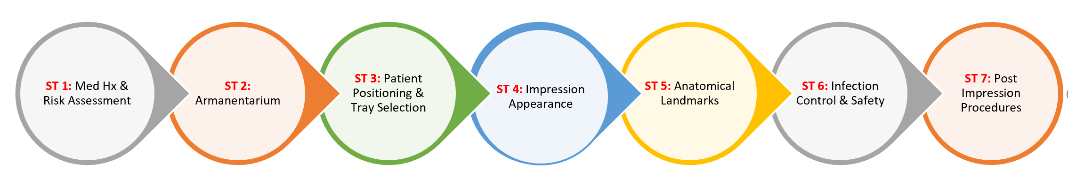
OSCE Map

Slide 13
OSCE Stations

Slide 14
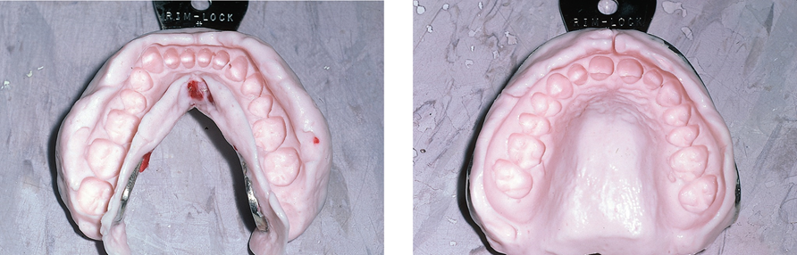
This OSCE focuses on Alginate impressions. You have 10 minutes to review the OSCE. Once 10 minutes are up, you will move forward to your first assigned station.
Station # 1- Introduction to OSCE
Instructions to the Students

Slide 15
Carefully read the information presented for this station and then answer the one question presented at this station. Always be mindful that you will have 5 minutes to complete this station.
Based upon the Medical History and Intraoral findings located on the next slide, please explain the rationale for taking alginate impressions on this patient.
Station #1
Medical History and Risk Assessment
Instructions to Students

Slide 16
Patient Profile: Patient isa 70-year old Asian male, 5’8” and weighs 200 lbs. He is a retired life insurance salesman.
Chief Complaint: “I am way overdue for my dental check-up.” I would like to have my teeth bleached they are very dark in color.
Dental History: In previous years he received regular dental care and was on a six month-recare appointment interval.
Medical History: He reports a history of cigar smoking, hypothyroidism, Parkinson’s disease, frequent bronchitis, GERD, and occasional angina. Five years ago he had a basal cell carcinoma removed from under his right eye. His daily medications are: (Simvastatin) Zocor®, (Metoprololsuccinate) Toprol®, (Levothyroxine) Synthroid®, (Lisinopril) Zestril®, (Levodopa) Sinemet®and 81 mg aspirin. His blood pressure was recorded at 138/88.
Extraoral Examination:
Clicking and popping was noted in each TMJ.
Mild and inconsistent facial tremors occurred.
Areas of tenderness posterior cervical lymph nodes are palpable.
Station #1
Medical History and Risk Assessment
Instructions to Students

Slide 17
Station #1
Medical History and Risk Assessment
Instructions to Faculty
Monitor students working on station #1. A grading rubric is to be used to evaluate students’ oral and written responses. Student will need to successfully explain the rationale for taking alginate impressions on this patient.

Slide 18
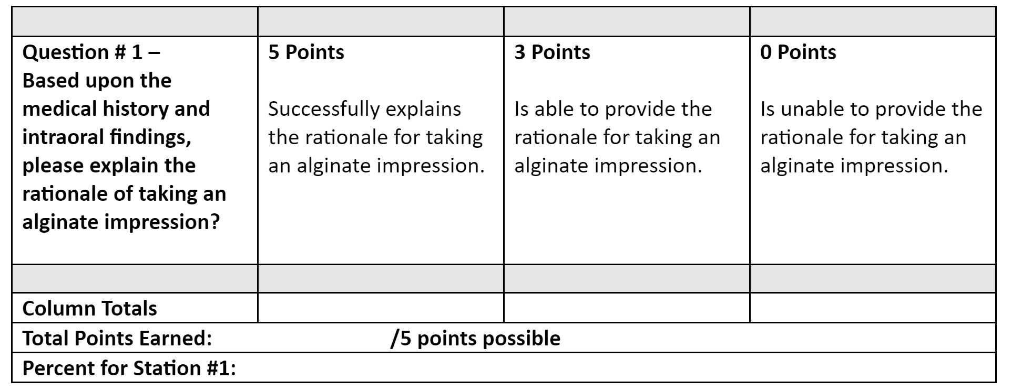
Instructions to Faculty: Circle the score for each row that best aligns with student’s response, add up the points for each column, add all for the final score, and divide by total number of points possible. Pass=75%
Station #1 -
Medical History and Risk Assessment
Grading Rubric

Slide 19
Carefully read the information presented for this station and then answer the one question presented at this station.
Always be mindful that you will have 5 minutes to complete this station.
Please describe what is the armamentarium/proper set up for taking alginate impressions.
Station #2
Armamentarium
Instructions to the Students

Slide 20
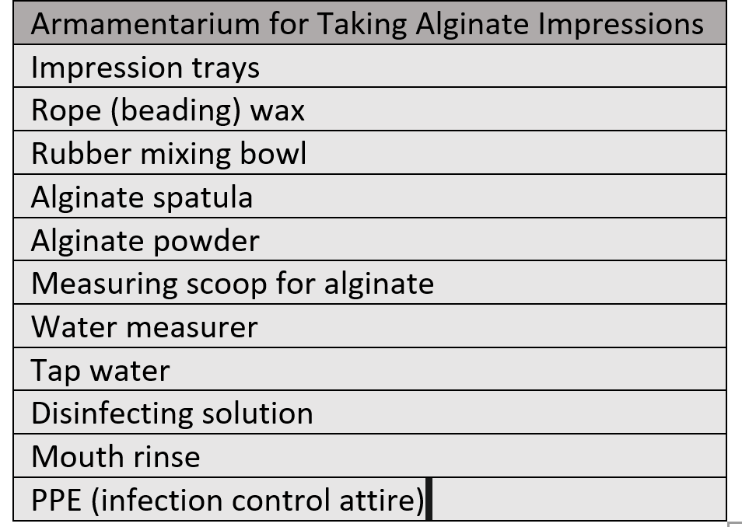
Monitor students working on station #2. A grading rubric is to be used to evaluate students’ oral and written responses. Students will describe the armamentarium/proper setup for an alginate impression. You can use this list as a guide.
Station #2
Armamentarium
Instructions to the Faculty

Slide 21
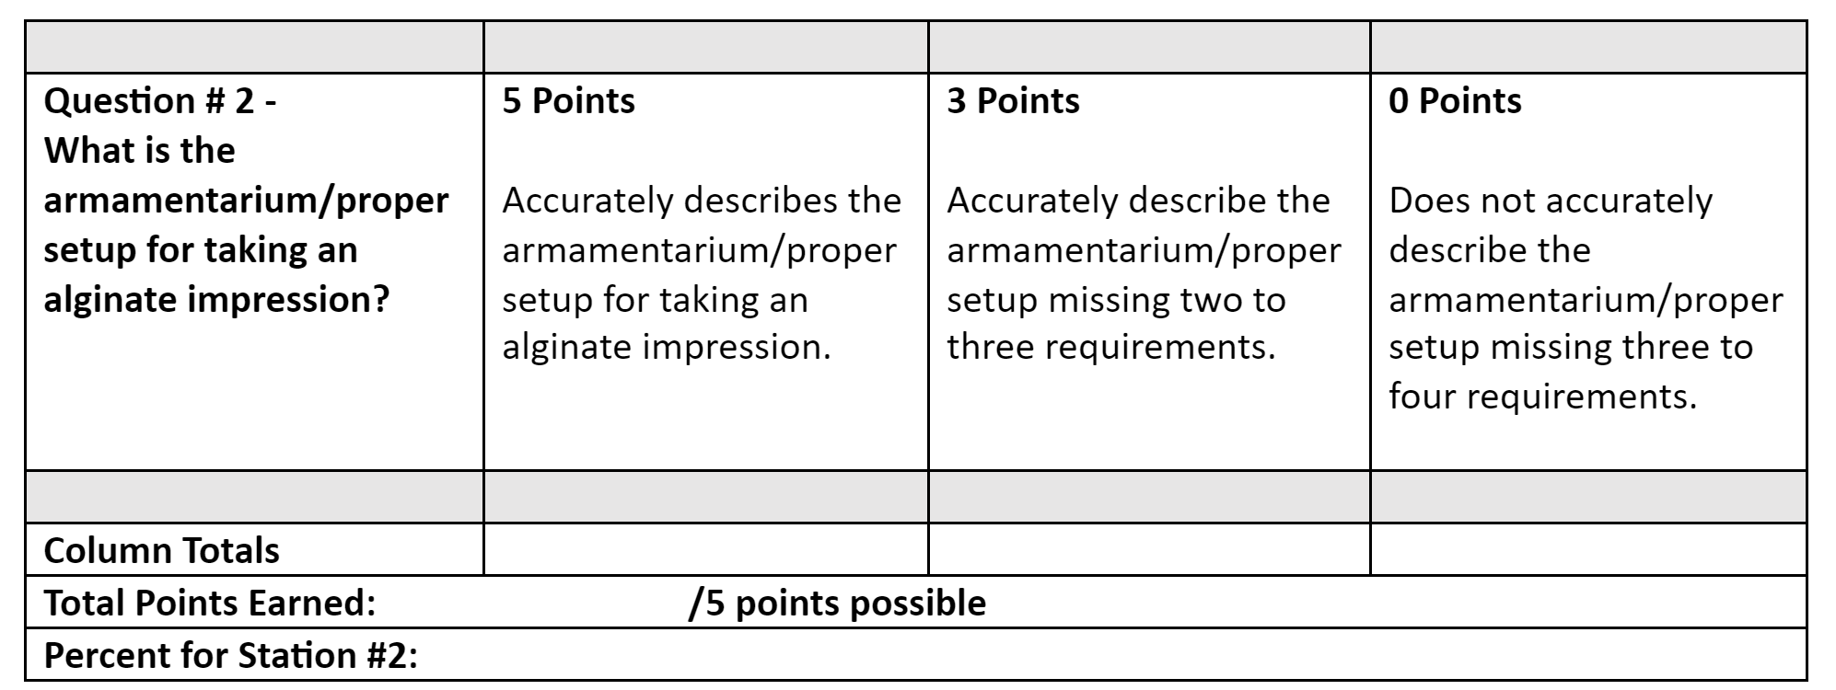
Instructions to Faculty: Circle the score for each row that best aligns with student’s response, add up the points for each column, add all for the final score, and divide by total number of points possible. Pass=75%
Station #2
Armamentarium
Grading Rubric

Slide 22
Carefully read the information presented for this station and then answer the one question presented at this station.
Always be mindful that you will have 5 minutes to complete this station.
Please explain proper patient positioning, clinician clock position, proper tray selection, and use of utility wax while taking alginate impressions.
Station #3
Patient Positioning and Tray Selection
Instructions to the Students

Slide 23
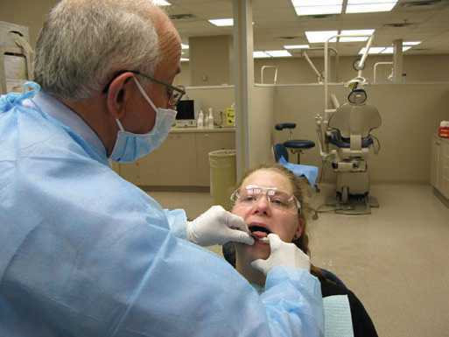
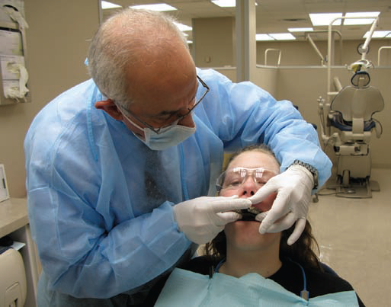
Monitor students working on station #3. A grading rubric is to be used to evaluate students’ oral and written responses. Student will need to describe proper patient position, clinician position, tray selection and use of utility wax during alginate impressions. Use images as a reference.
Station #3
Patient Positioning and Tray Selection
Instructions to the Faculty

Slide 24
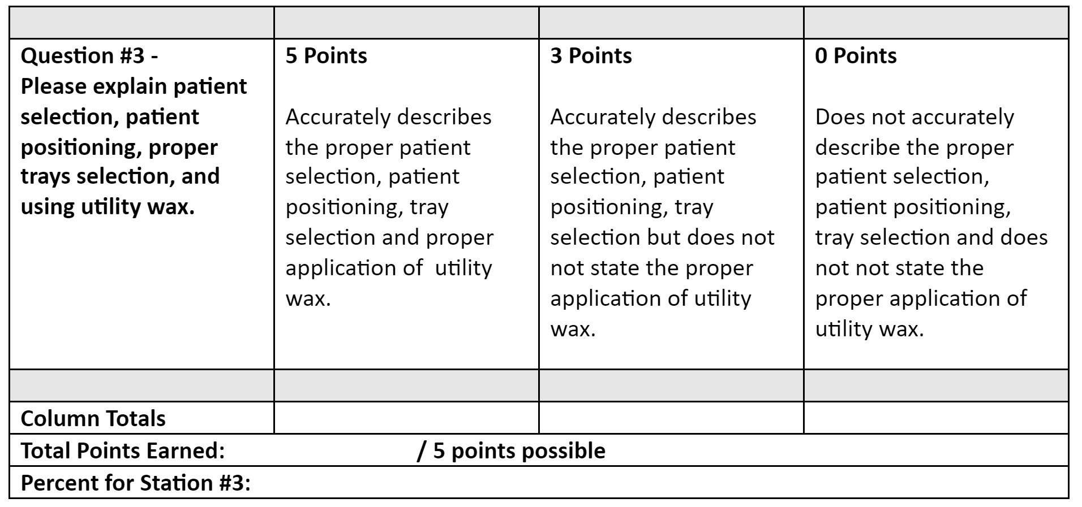
Instructions to Faculty: Circle the score for each row that best aligns with student’s response, add up the points for each column, add all for the final score, and divide by total number of points possible. Pass=75%
Station #3
Patient Positioning and Tray Selection
Grading Rubric

Slide 25
Carefully read the information presented for this station and then answer the one question presented at this station.
Always be mindful that you will have 5 minutes to complete this station.
Please describe the process of mixing, seating, and removing an alginate impression
Station #4
Impression Appearance
Instructions to Students

Slide 26
Monitor students working on station #4. A grading rubric is to be used to evaluate students’ oral and written responses. Student should accurately describe the process of mixing, seating, and removing an alginate impression
Station #4
Impression Appearance
Instructions to the Faculty

Slide 27
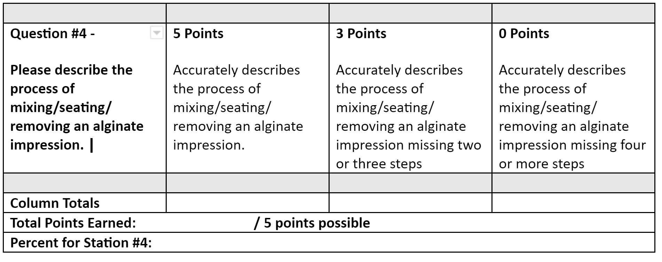
Instructions to Faculty: Circle the score for each row that best aligns with student’s response, add up the points for each column, add all for the final score, and divide by total number of points possible. Pass=75%
Station #4
Impression Appearance
Grading Rubric

Slide 28
Carefully read the information presented for this station and then answer the one question presented at this station. Always be mindful that you will have 5 minutes to complete this station.
Describe what a successful alginate impression looks like? Please explain the anatomical landmarks that need to be present for an adequate alginate impression.
Station #5
Anatomical Landmarks
Instructions to the Students

Slide 29
Monitor students working on station #5. A grading rubric is to be used to evaluate students’ written responses. Student will accurately identify all anatomical landmarks for an adequate alginate impression.
Station #5
Anatomical Landmarks
Instructions to the Faculty

Slide 30
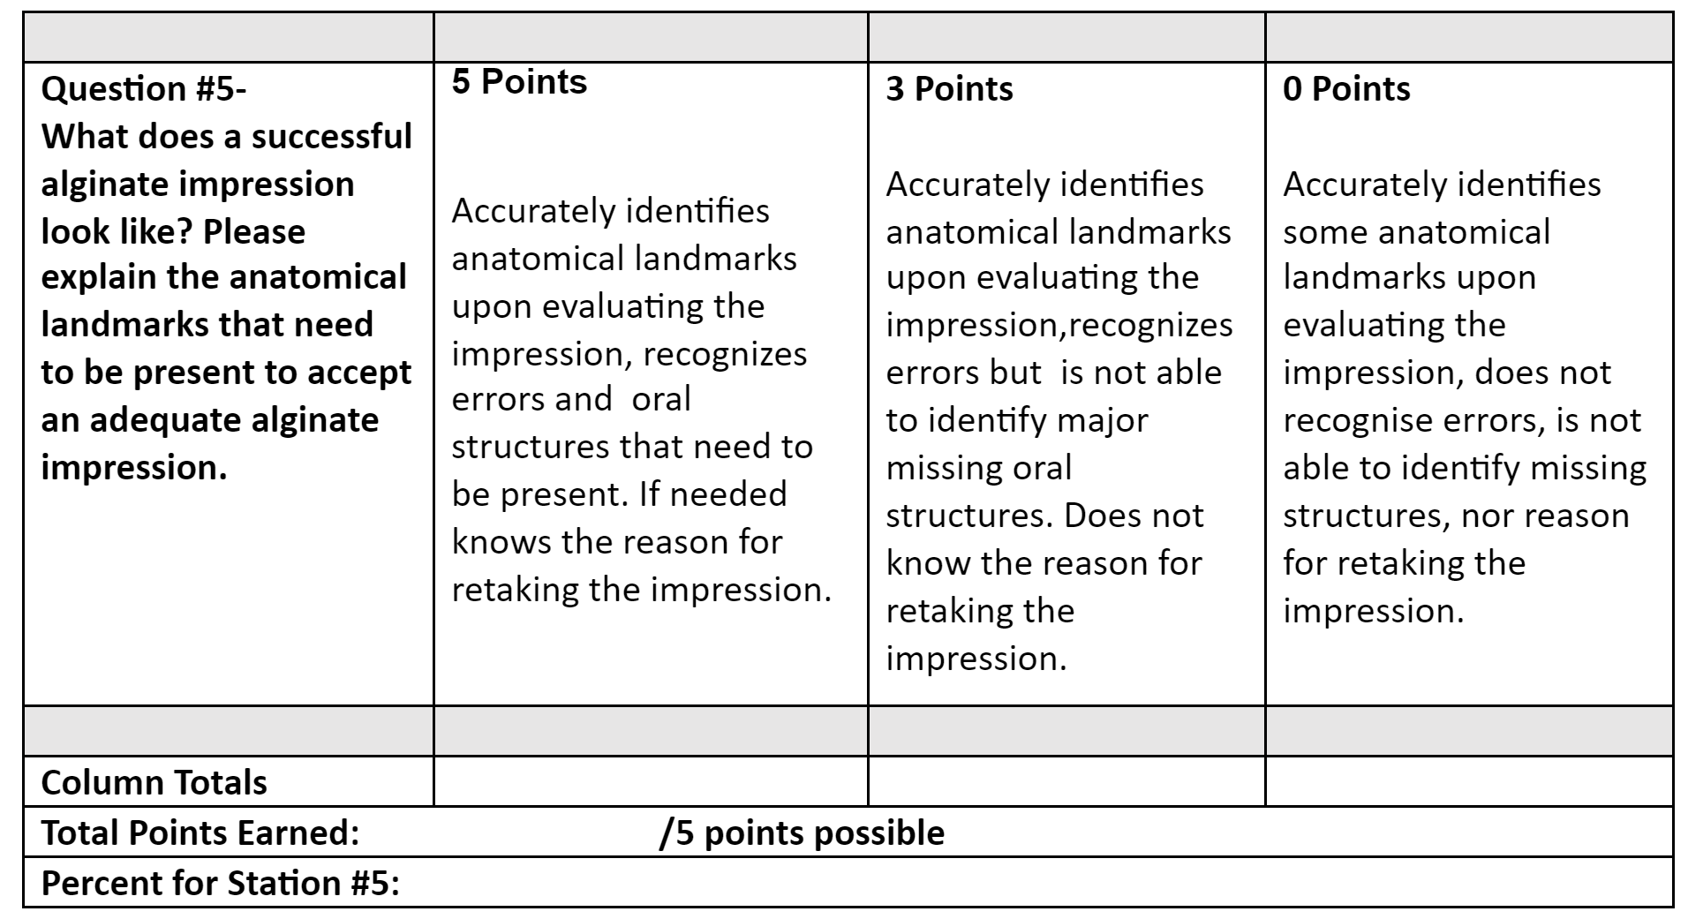
Instructions to Faculty: Circle the score for each row that best aligns with student’s response, add up the points for each column, add all for the final score, and divide by total number of points possible. Pass=75%
Station #5
Anatomical Landmarks
Grading Rubric

Slide 31
Carefully read the information presented for this station and then answer the one question presented at this station. Always be mindful that you will have 5 minutes to complete this station.
Please explain the disinfection process and storage prior to pouring an alginate impression.
Station #6
Infection Control & Safety
Instructions to Students

Slide 32
Monitor students working on station #6. A grading rubric is to be used to evaluate students’ written responses. Student should accurately understand and describe the safety and handling of impression materials.
Station #6
Infection Control & Safety
Instructions to the Faculty

Slide 33
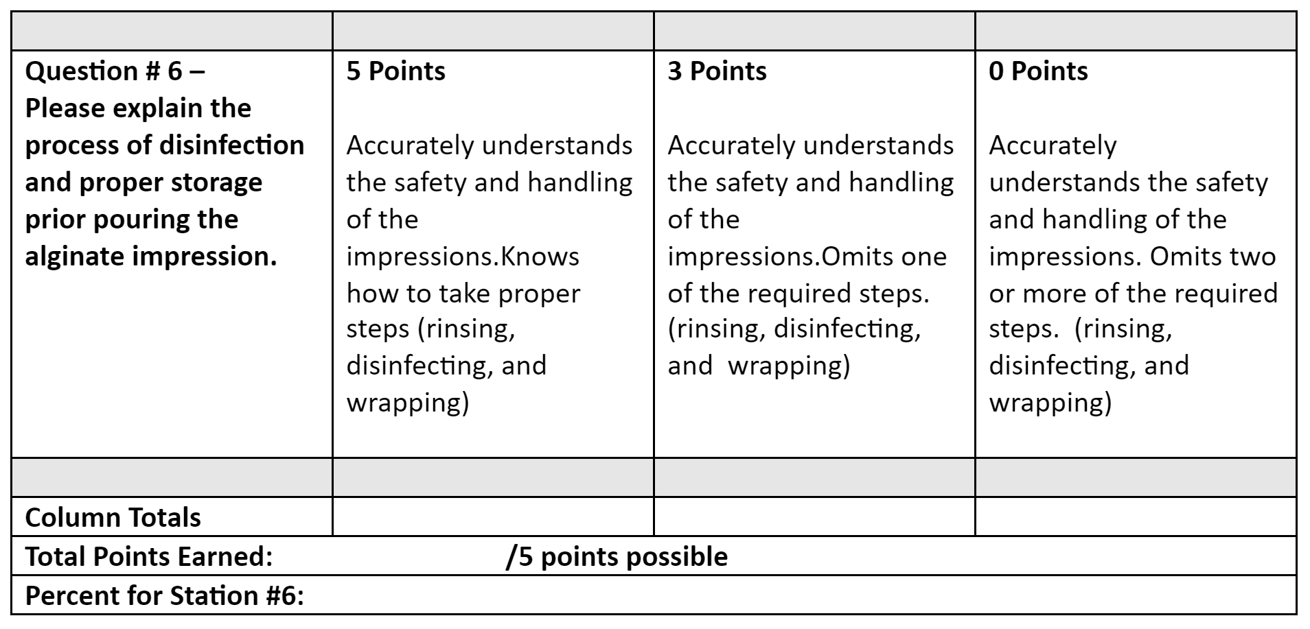
Instructions to Faculty: Circle the score for each row that best aligns with student’s response, add up the points for each column, add all for the final score, and divide by total number of points possible. Pass=75%
Station #6
Infection Control & Safety
Grading Rubric

Slide 34
Carefully read the information presented for this station and then answer the one question presented at this station. Always be mindful that you will have 5 minutes to complete this station.
You’ve completed taking alginate impressions on your patient. Describe what must be checked prior to dismissal? Describe the safety and handling of the impression and post operative disinfection.
Station #7
Post Impression Procedures
Instructions to Students

Slide 35
Monitor students working on station #7. A grading rubric is to be used to evaluate students’ written responses. Student will successfully explain the rationale of dismissing the patient, safety and handling of the impression material and discuss post operative disinfection.
Station #7
Post Impression Procedures
Instructions to the Faculty

Slide 36
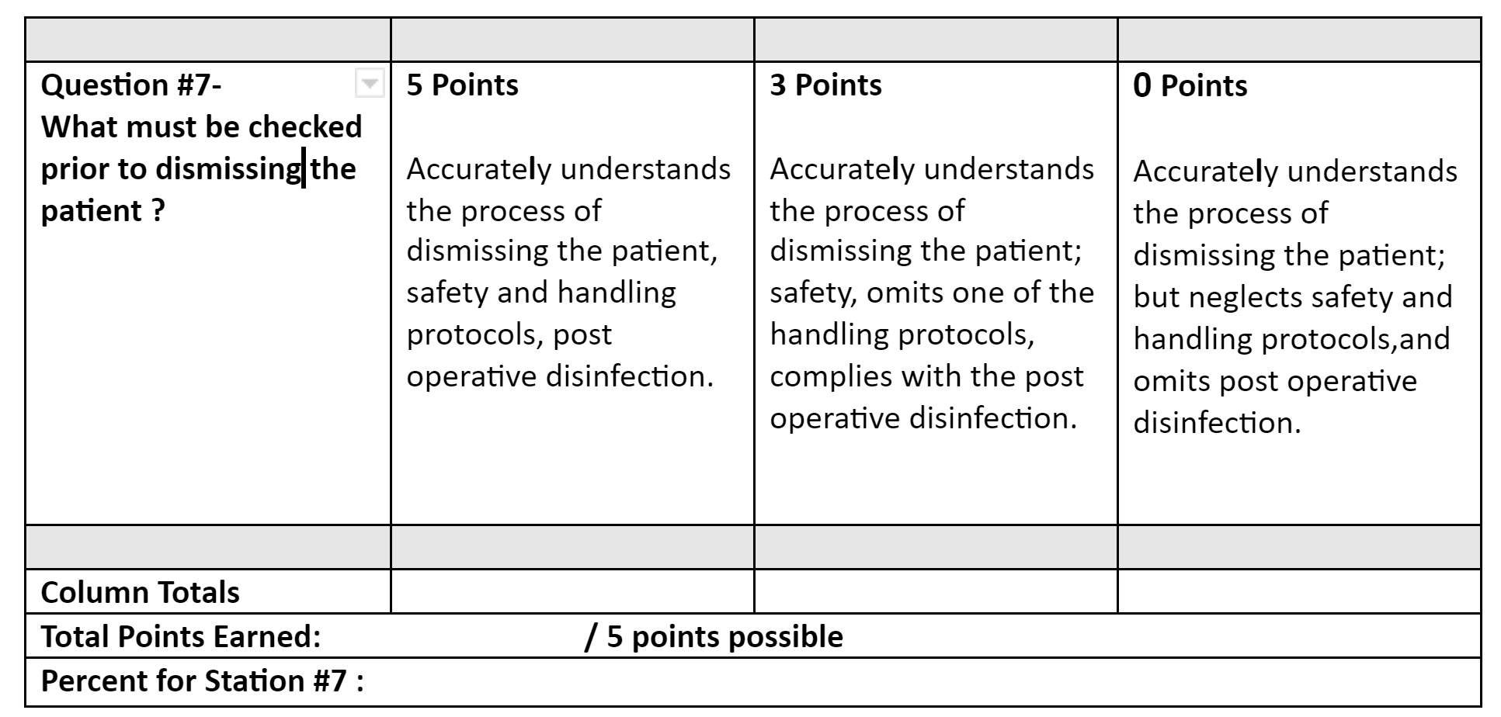
Instructions to Faculty: Circle the score for each row that best aligns with student’s response, add up the points for each column, add all for the final score, and divide by total number of points possible. Pass=75%
Station #7
Post Impression Procedures
Grading Rubric

Slide 37
OSCE Evaluation: Examples
Student Performance
Class Performance
Curriculum

Slide 38
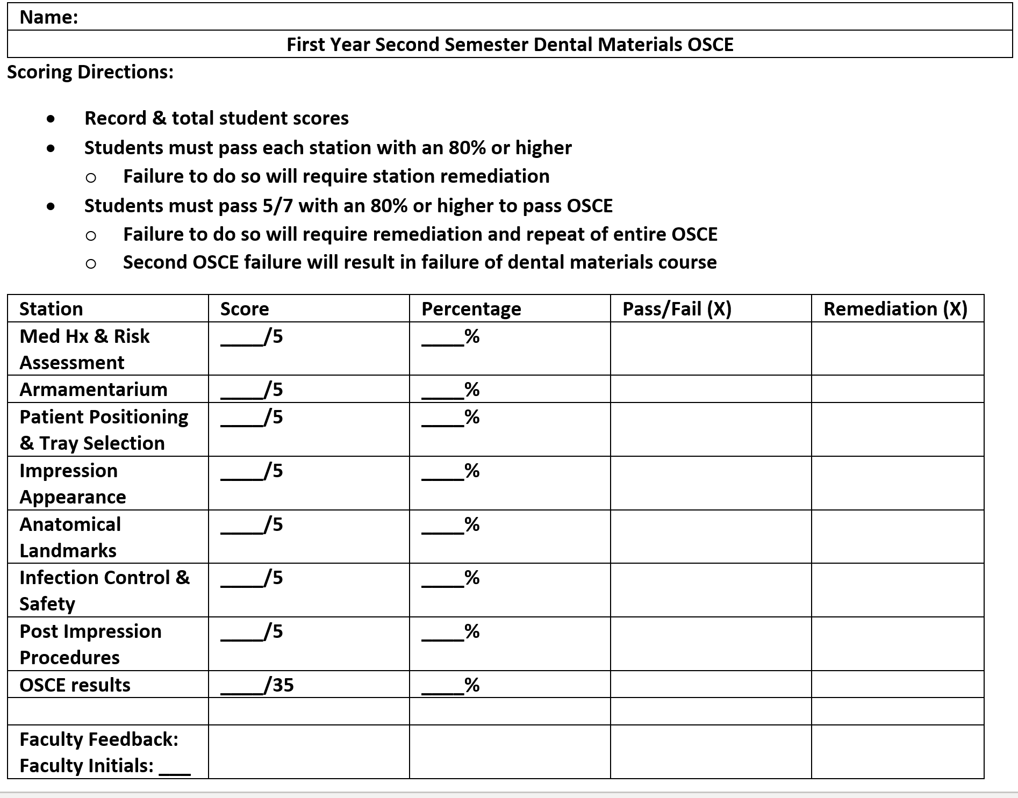
OSCE Evaluation
Student Performance

Slide 39
OSCE Evaluation
Class Performance
Class Assessment Directions: Record class average scores & percentages. Record frequency of pass, failure, & remediation rates.
Station | Average | Average % | Total Pass | Total Fail | Total Remediations
Med Hx & Risk | _____/5 | _____%
Armamentarium | _____/5 | _____%
Patient Position | _____/5 | _____%
Imp Appearance | _____/5 | _____%
Anatomical land | _____/5 | _____%
Inf. control & safety Post imp procedures | _____/5 _____/5 | _____% _____%
OSCE Results: | ____/35 | _____%

Slide 40
OSCE Evaluation
Curriculum
Based on student performance:
Did the OSCE identify any curriculum strengths?
Did the OSCE identify any potential curriculum weaknesses?
Plans to modify curriculum based on OSCE results?

