Slide 1


OSCE
Silver Diamine Fluoride (SDF)

Slide 2

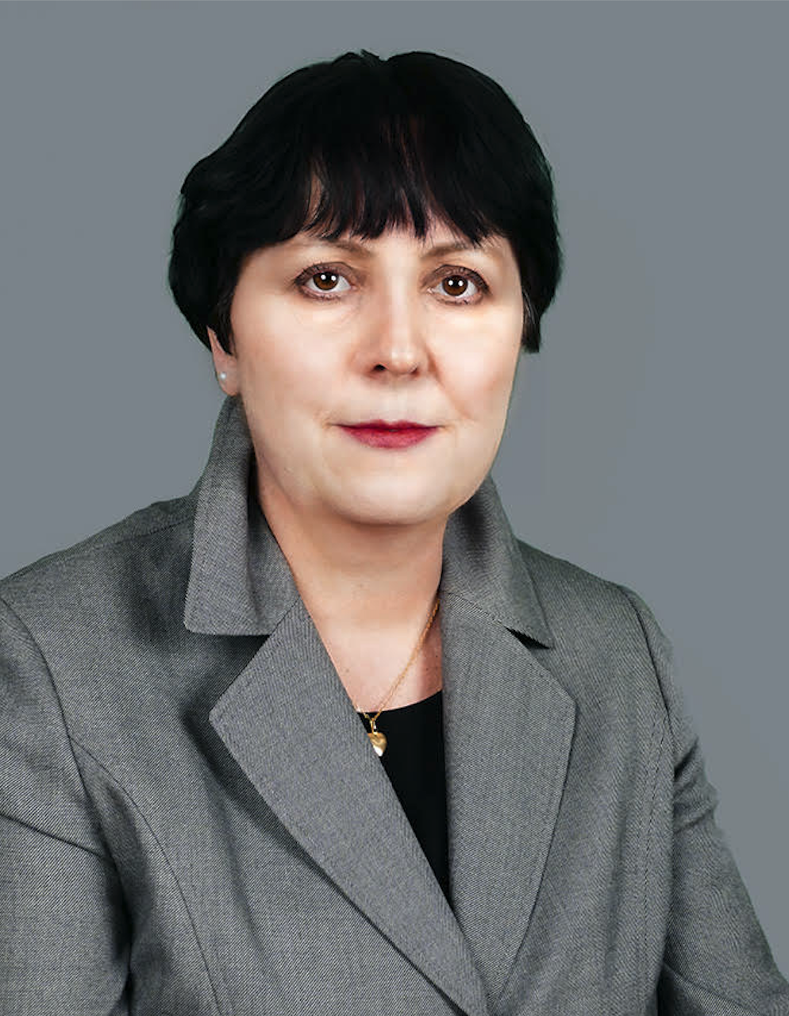
MEET THE EDUCATORS
Kim Attanasi, PhD, MS, RDH
Aleksandra Czaplinska, BEd, BS, RDH

Slide 3
Dental Anatomy
Principles of Dental Hygiene 1
Lecture and Clinic
OVERVIEW OF CONTENT

Slide 4
Target Population

Slide 5
First year, second semester dental hygiene students in a virtual or face-to-face setting.
Target Population

Slide 6
CODA Standards

Slide 7
Standard 2 – Educational Program
  2-8a
  2-8c
  2-8d
  2-12
  2-13
  2-15
  2-18
  2-19
  2-21
  2-23
CODA STANDARDS

Slide 8
Presentation Format Overview
This is a timed OSCE where students rotate through stations either virtual or in a face-to-face environment. Students will be allowed 5 minutes per station to answer questions presented at each station.
See OSCE instructions in the resource section for additional information.

Slide 9
Software and Equipment Requirements
For Virtual Format
Microsoft PowerPoint or Google Slides
Internet connection with broadband of 3G or faster
Computer, laptop, tablet or iPad
LMS Platform supported by your institution
Highly recommended is the utilization of lockdown services, proctoring of exam via Zoom, or other security measures available with your LMS platform.

Slide 10
Equipment Requirements
For Face-to-Face Format
A room or space that will allow for 8 independent stations.
Each station will need a computer with Internet access, an area where students can sit to read each station’s information and respond to questions.
LMS Platform, supported by your institution, if students will be answering question directly into a software program OR hard copy answer sheets.

Slide 11
OSCE Map
SEE EXAMPLE ON NEXT SLIDE

Slide 12
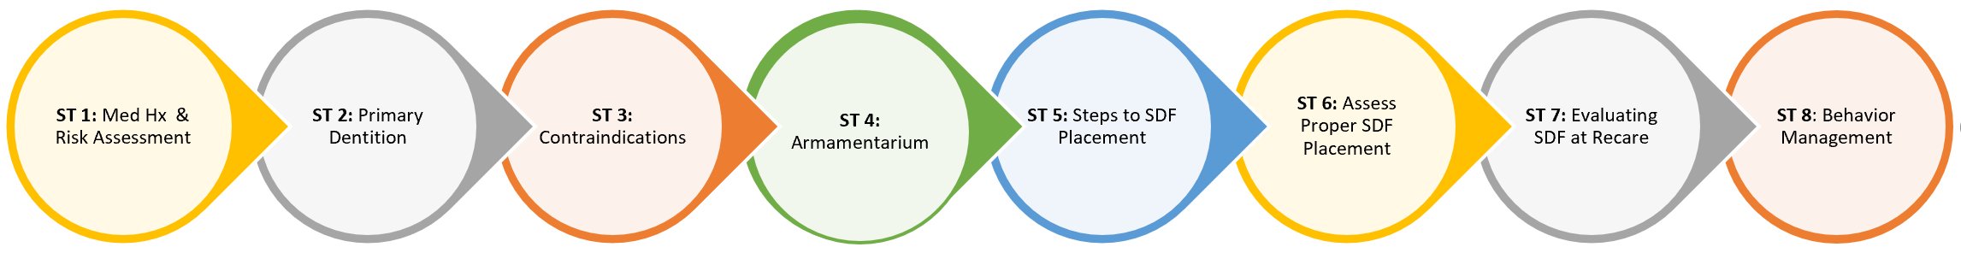
OSCE Map

Slide 13
OSCE Stations

Slide 14
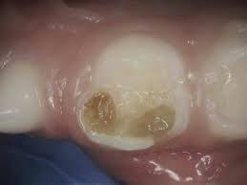
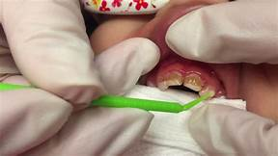
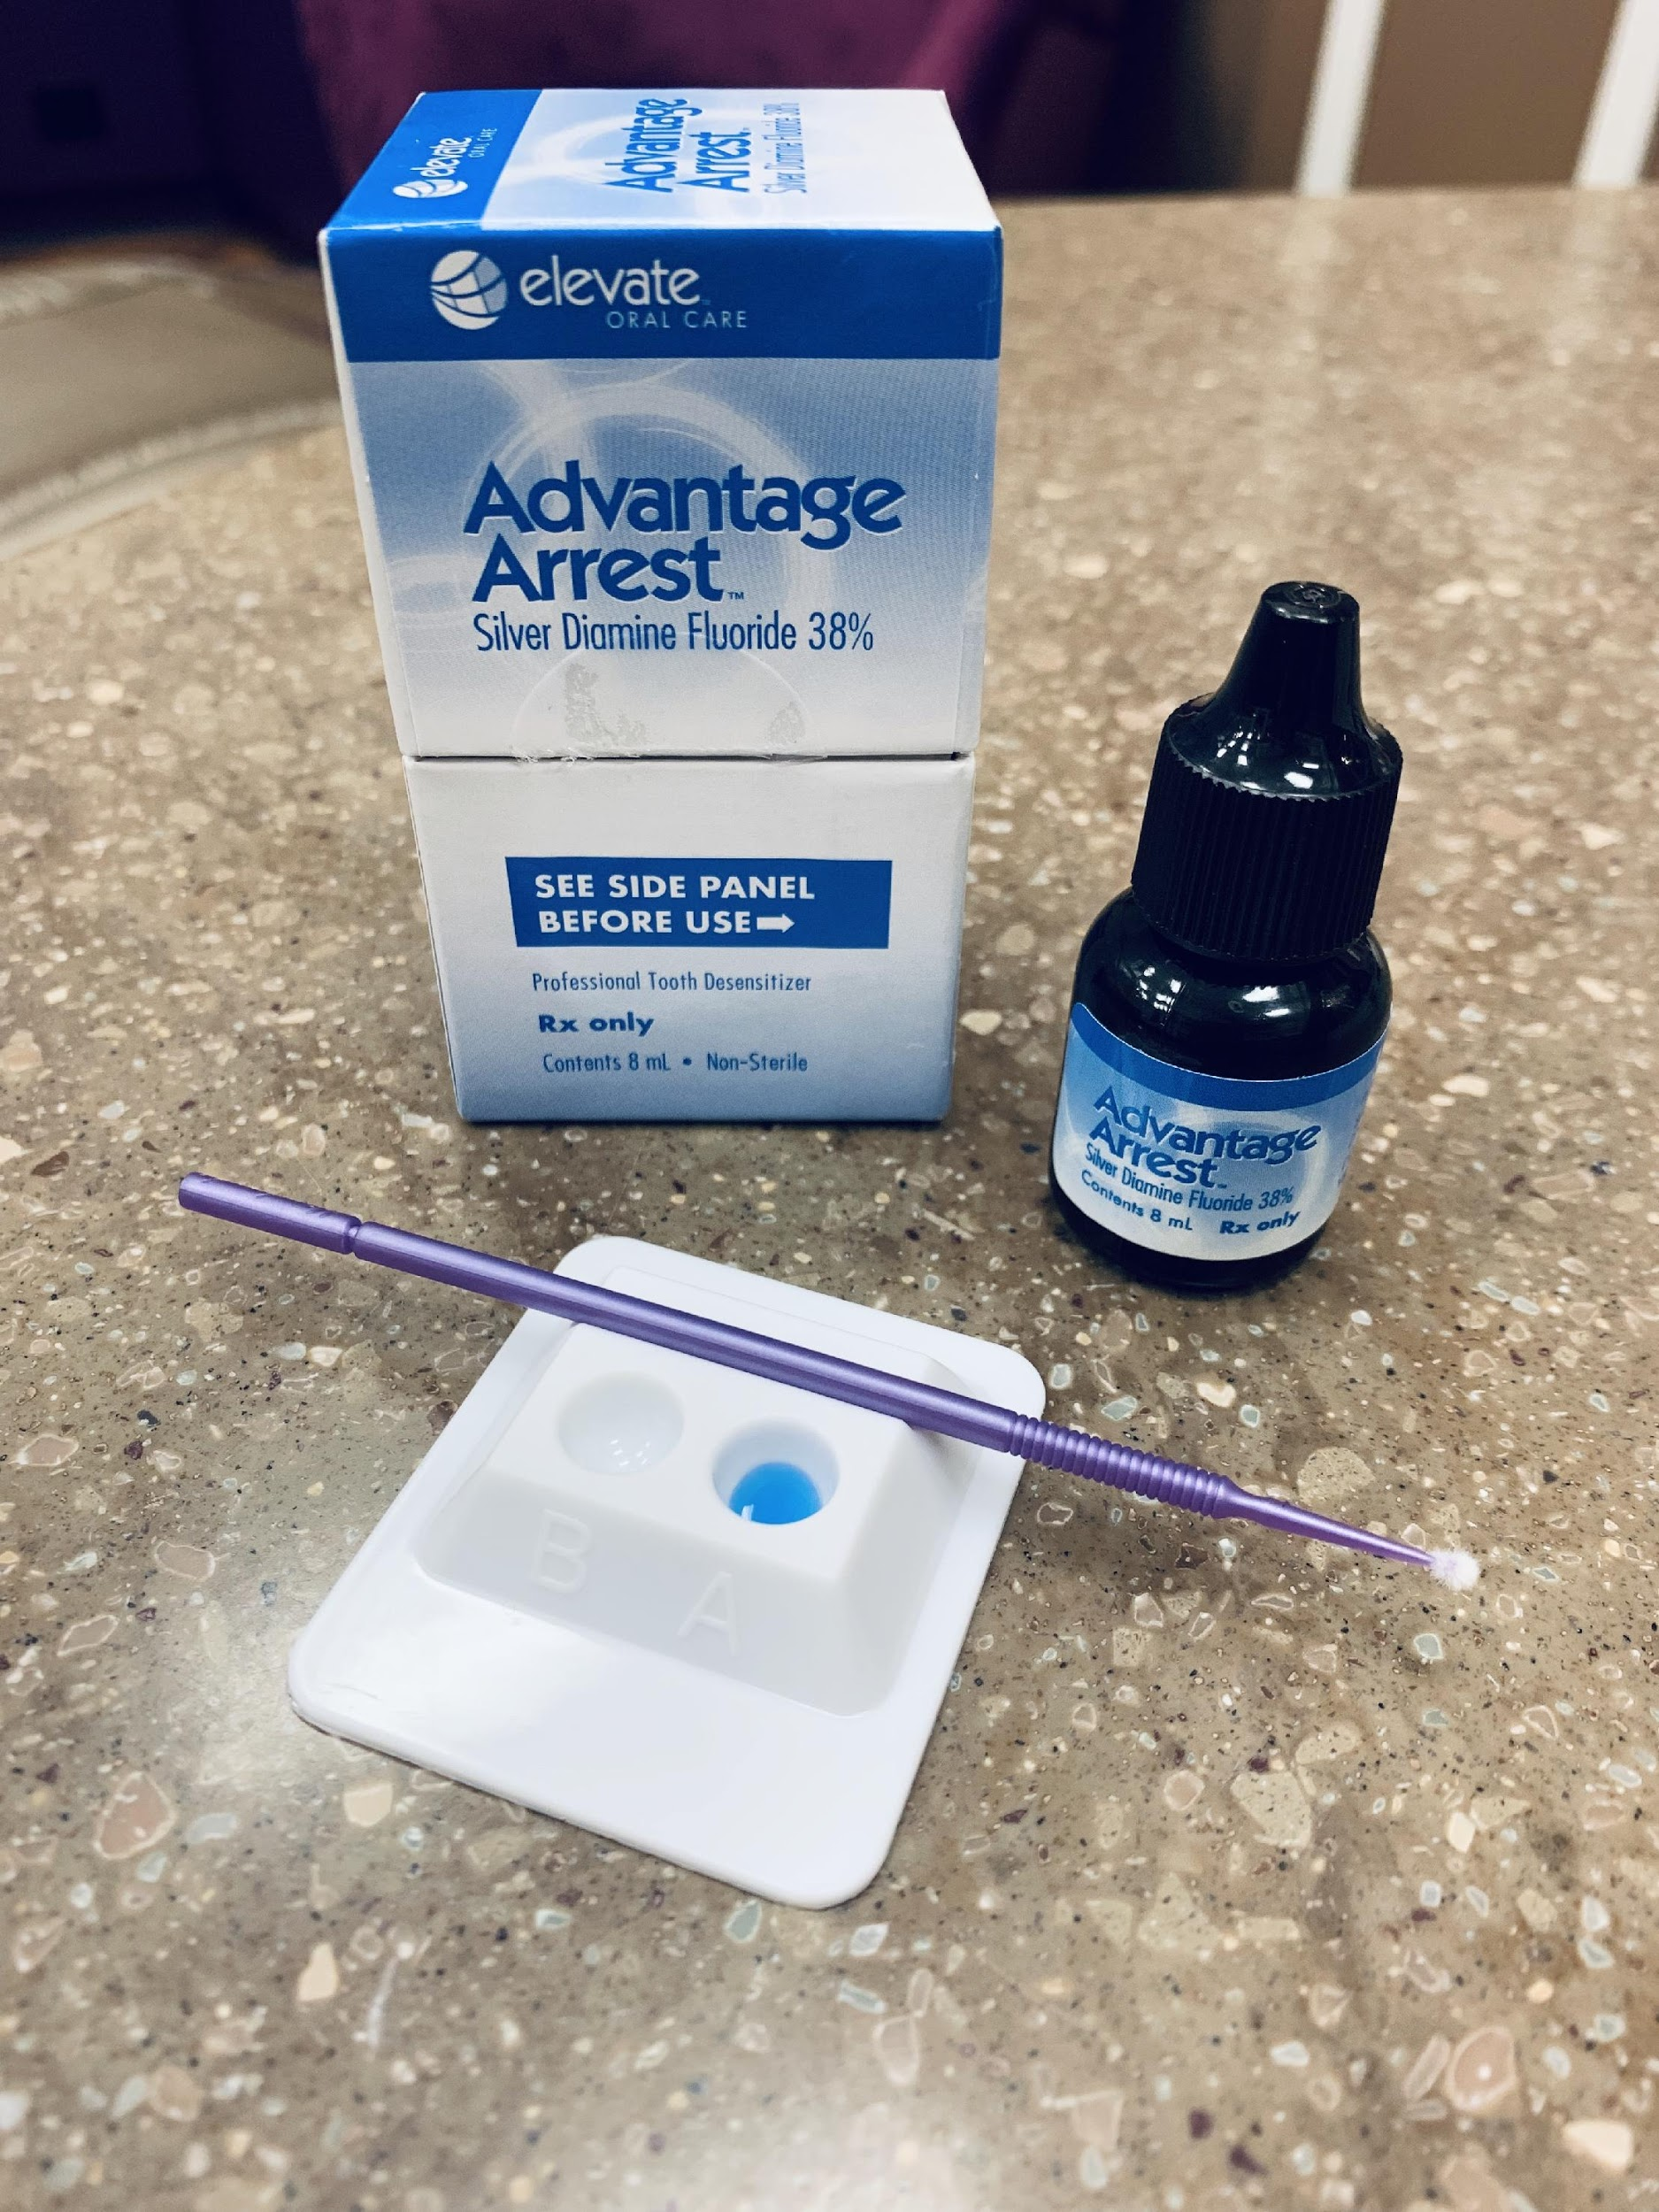
This OSCE focuses on SDF. You have 10 minutes to review the OSCE. Once 10 minutes are up, you will move forward to your first assigned station.
SDF Introduction
Instructions to the Students

Slide 15
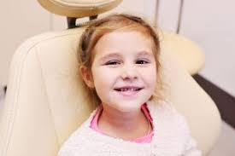
Station #1a - Maria
Medical History, Risk Assessment & Informed Parental Consent
Patient Profile: Maria Saffron, 2 year old, female, using a bottle at night, mom concerned about teeth looking yellow.
Medical History: No medications, no known allergies, vitals WNL.
Extraoral Examination: Notice slight symmetry of mandible off to the right, no clicking or popping at this time.
Intraoral Examination: Moderate plaque accumulation, generalized inflammation, rampant caries, short maxillary frenum.
Dental History: This is the first time the child has been to the dentist. Thumb sucker. Slightly anxious.

Slide 16
Station #1a - Maria
Instructions to Students
Carefully read the information presented for this station and then answer the one question presented at this station. Thoroughly provide information to support your response. Always be mindful that you will have 5 minutes to complete this station.
When reviewing the medical history with either the parent(s) or caregiver, did you recognize any contraindications or medical concerns to the application of SDF on Maria?

Slide 17
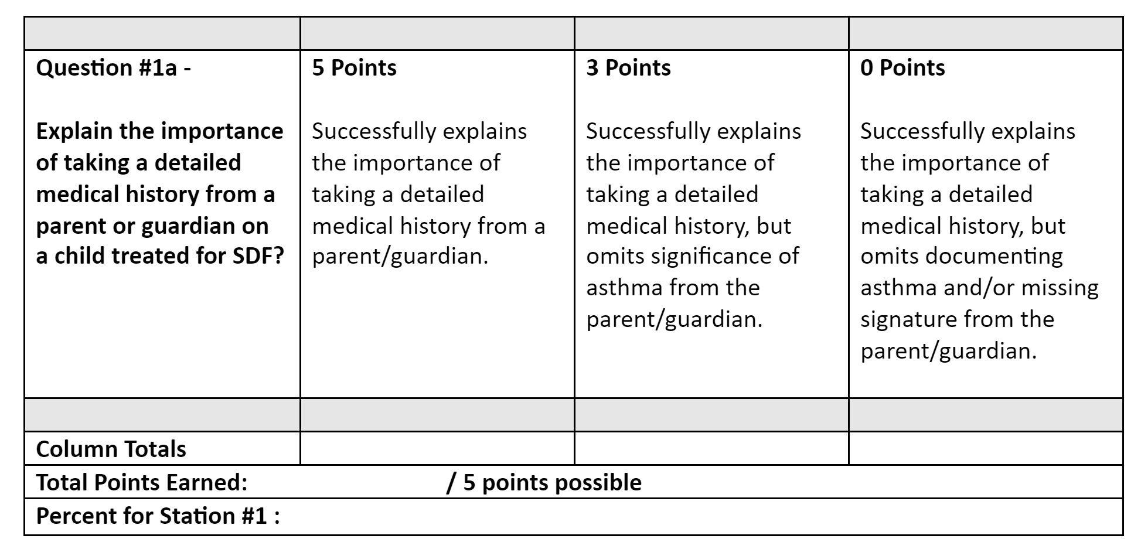
Station #1a - Maria
Medical History
Grading Rubric
Instructions to Faculty: Circle the score for each row that best aligns with student’s response, add up the points for each column, add all for the final score, and divide by total number of points possible. Pass=75%

Slide 18
Station #1b - Maria
Risk Assessment
Instructions to Students
Carefully read the information presented for this station and then answer the one question presented at this station. Thoroughly provide information to support your response. Always be mindful that you will have 5 minutes to complete this station.
Based upon Maria’s clinical findings and dental history what is Maria’s caries risk? Provide specific recommendations based upon the identified risk factors. What questions might you want to further ask the parent or caregiver?

Slide 19
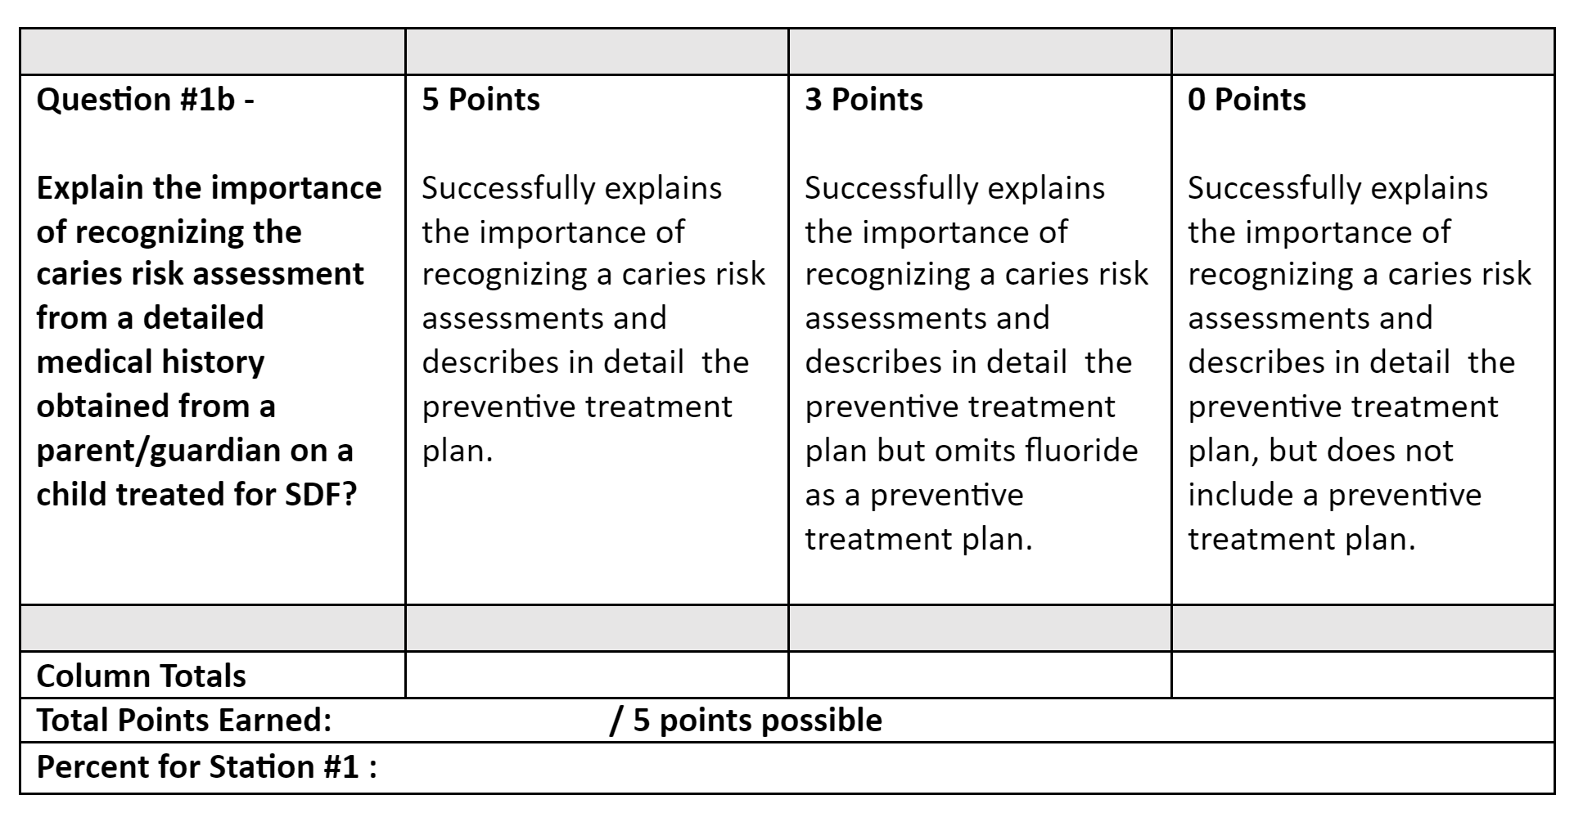
Station #1b - Maria
Risk Assessment
Grading Rubric
Instructions to Faculty: Circle the score for each row that best aligns with student’s response, add up the points for each column, add all for the final score, and divide by total number of points possible. Pass=75%

Slide 20
Station #1c - Maria
Informed Consent
Instructions to Students
Carefully read the information presented for this station and then answer the one question presented at this station. Thoroughly provide information to support your response. Always be mindful that you will have 5 minutes to complete this station.
Informed consents are specific to the procedure being recommended. What specific items would you like to see included in an informed consent for SDF treatment and why?

Slide 21
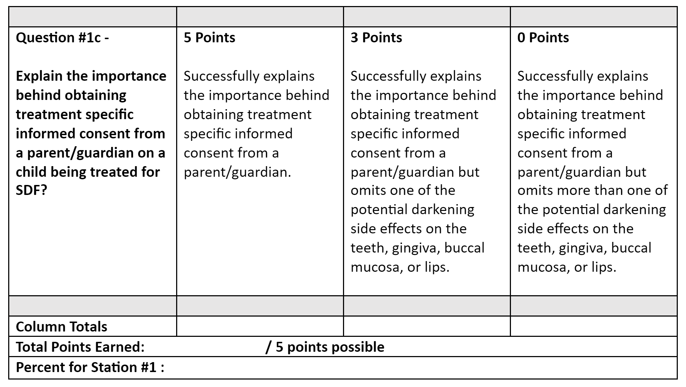
Station #1c - Maria
Informed Consent
Grading Rubric
Instructions to Faculty: Circle the score for each row that best aligns with student’s response, add up the points for each column, add all for the final score, and divide by total number of points possible. Pass=75%

Slide 22
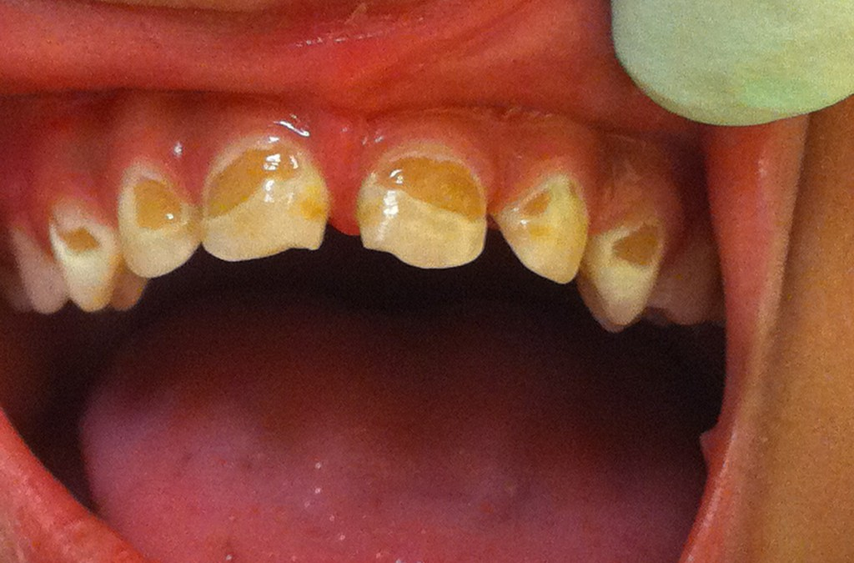
Carefully read the information presented for this station and then answer the one question presented at this station. Always be mindful that you will have 5 minutes to complete this station.
Chart in Axium the teeth which will need SDF?
Station # 2 -
Primary Dentition Charting
Instructions to the Students

Slide 23
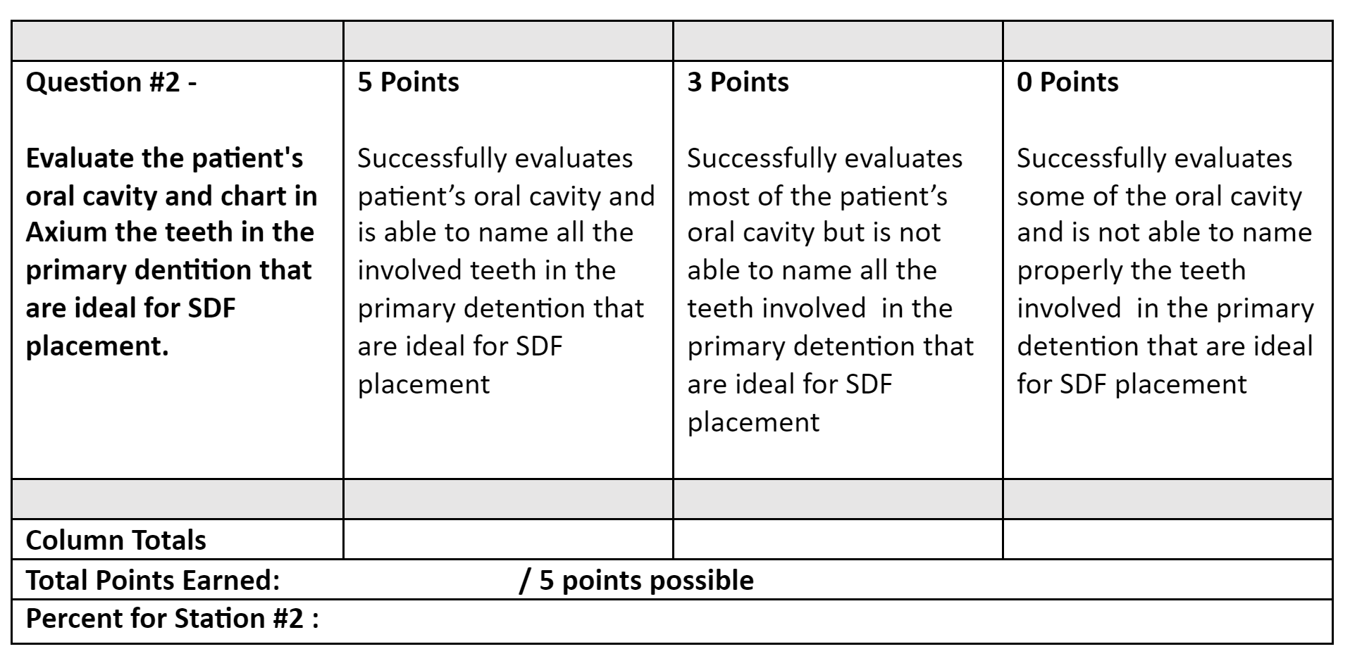
Instructions to Faculty: Circle the score for each row that best aligns with student’s response, add up the points for each column, add all for the final score, and divide by total number of points possible. Pass=75%
Station #2 -
Primary Dentition Charting
Grading Rubric

Slide 24
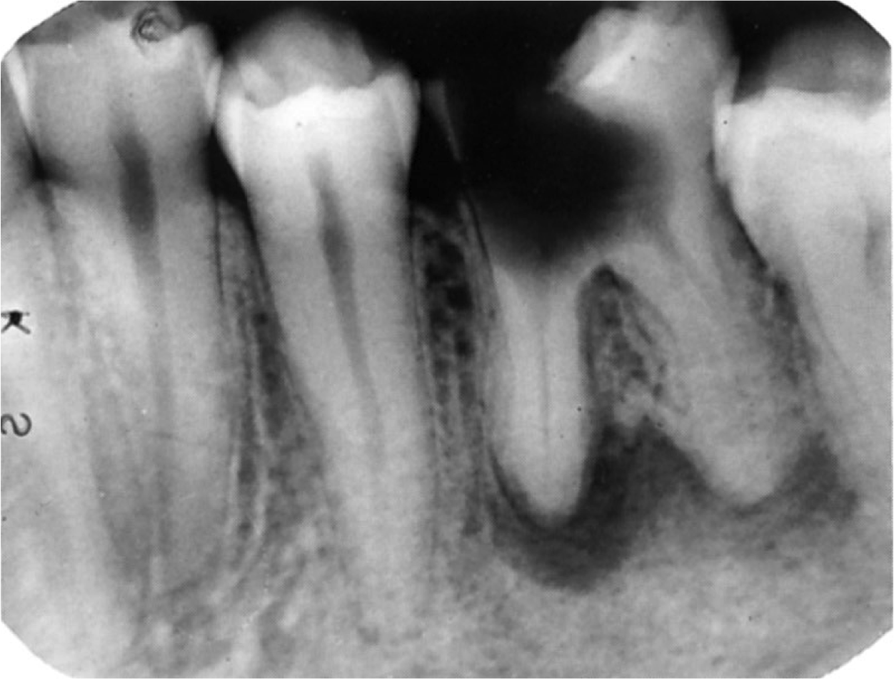
A 28 year old, male presents to the office with a chief complaint of sensitivity in the lower left quadrant. Reviewed medical history, no significant findings. Patient says “recently unemployed, no insurance, & presently unable to afford dental care.” 1 periapical radiograph was taken of #19.
Station # 3 -
Contraindications to Treatment
Instructions to the Students

Slide 25
Carefully read the information presented for this station and then answer the one question presented at this station. Always be mindful that you will have 5 minutes to complete this station.
Would SDF be a treatment of choice?
Station # 3 -
Contraindications to Treatment
Instructions to the Students

Slide 26
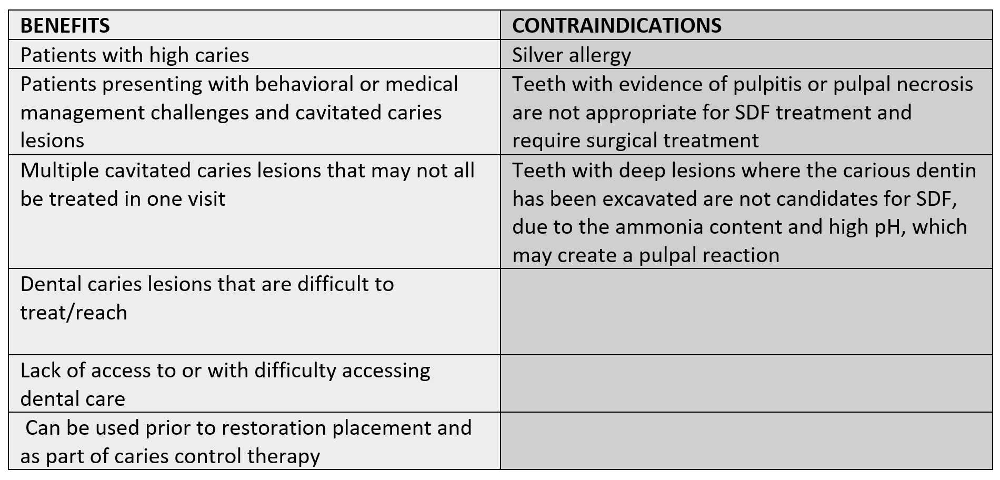
Station #3
Contraindications to Treatment
Instructions to Faculty
Monitor students working on station #3. List is provided as a guide for faculty. A grading rubric is to be used to evaluate students’ written responses.

Slide 27
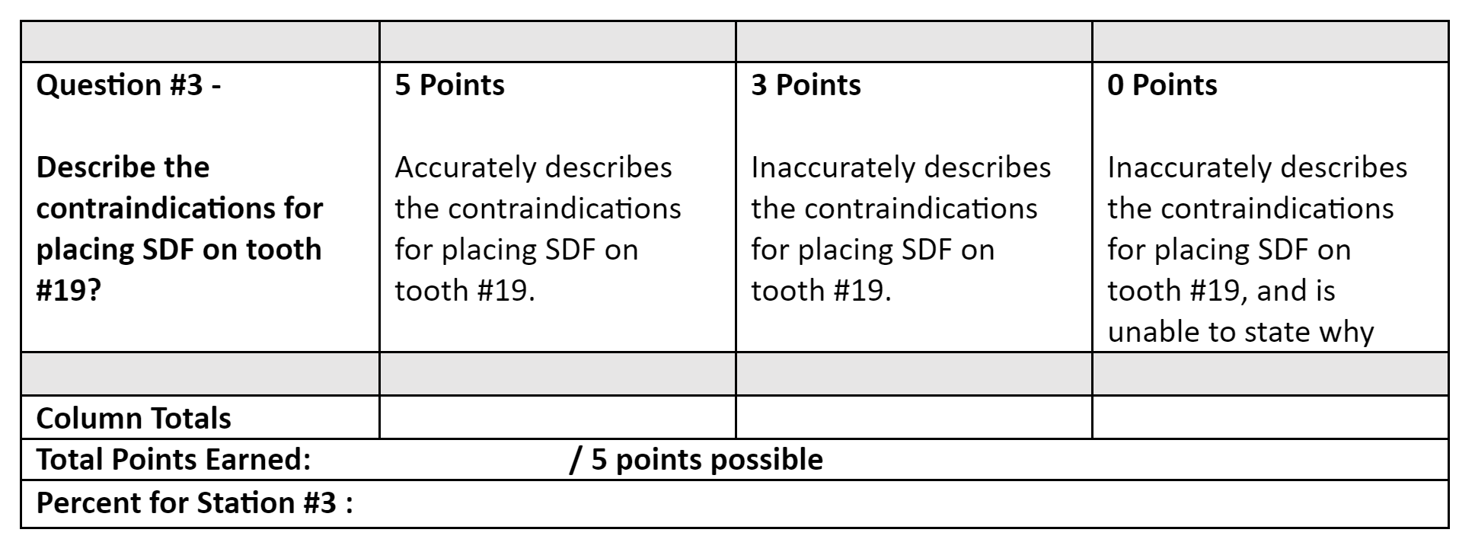
Instructions to Faculty: Circle the score for each row that best aligns with student’s response, add up the
points for each column, add all for the final score, and divide by total number of points possible. Pass=75%
Station #3 -
Contraindications to Treatment
Grading Rubric

Slide 28
Carefully read the information presented for this station and then answer the one question presented at this station. Always be mindful that you will have 5 minutes to complete this station.
Summarize proper patient set up and necessary armamentarium for SDF placement?
Station # 4-
Armamentarium
Instructions to the Students

Slide 29
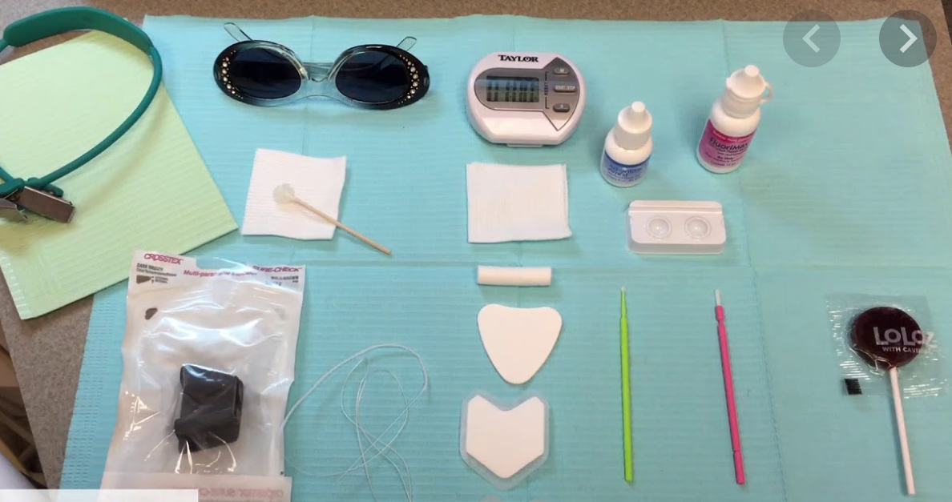
Station # 4
Armamentarium
Instructions to Faculty
Monitor students working on station #4. Images can guide faculty.
A grading rubric is to be used to evaluate students’ written responses.

Slide 30
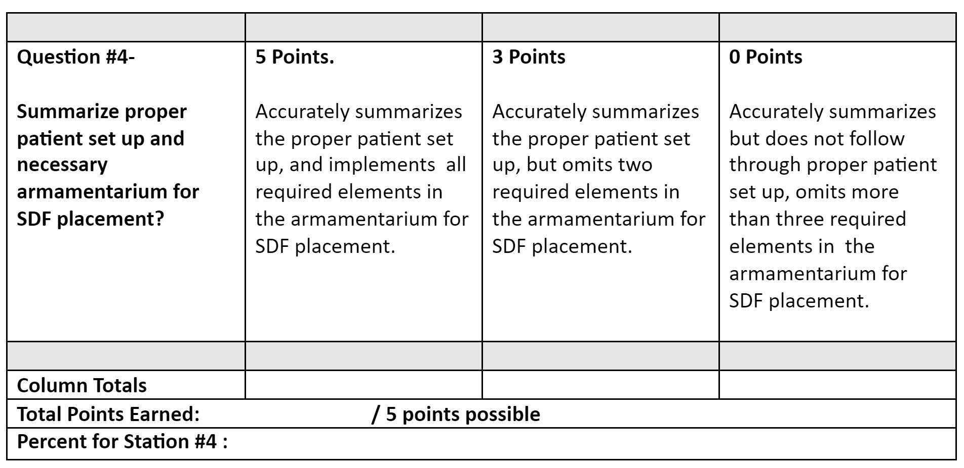
Instructions to Faculty: Circle the score for each row that best aligns with student’s response, add up the points for each column, add all for the final score, and divide by total number of points possible. Pass=75%
Station #4 -
Armamentarium
Grading Rubric

Slide 31
Carefully read the information presented for this station and then answer the one question presented at this station. Always be mindful that you will have 5 minutes to complete this station.
Describe the steps for proper SDF placement.
Station # 5 -
Steps to SDF Placement
Instructions to the Students

Slide 32
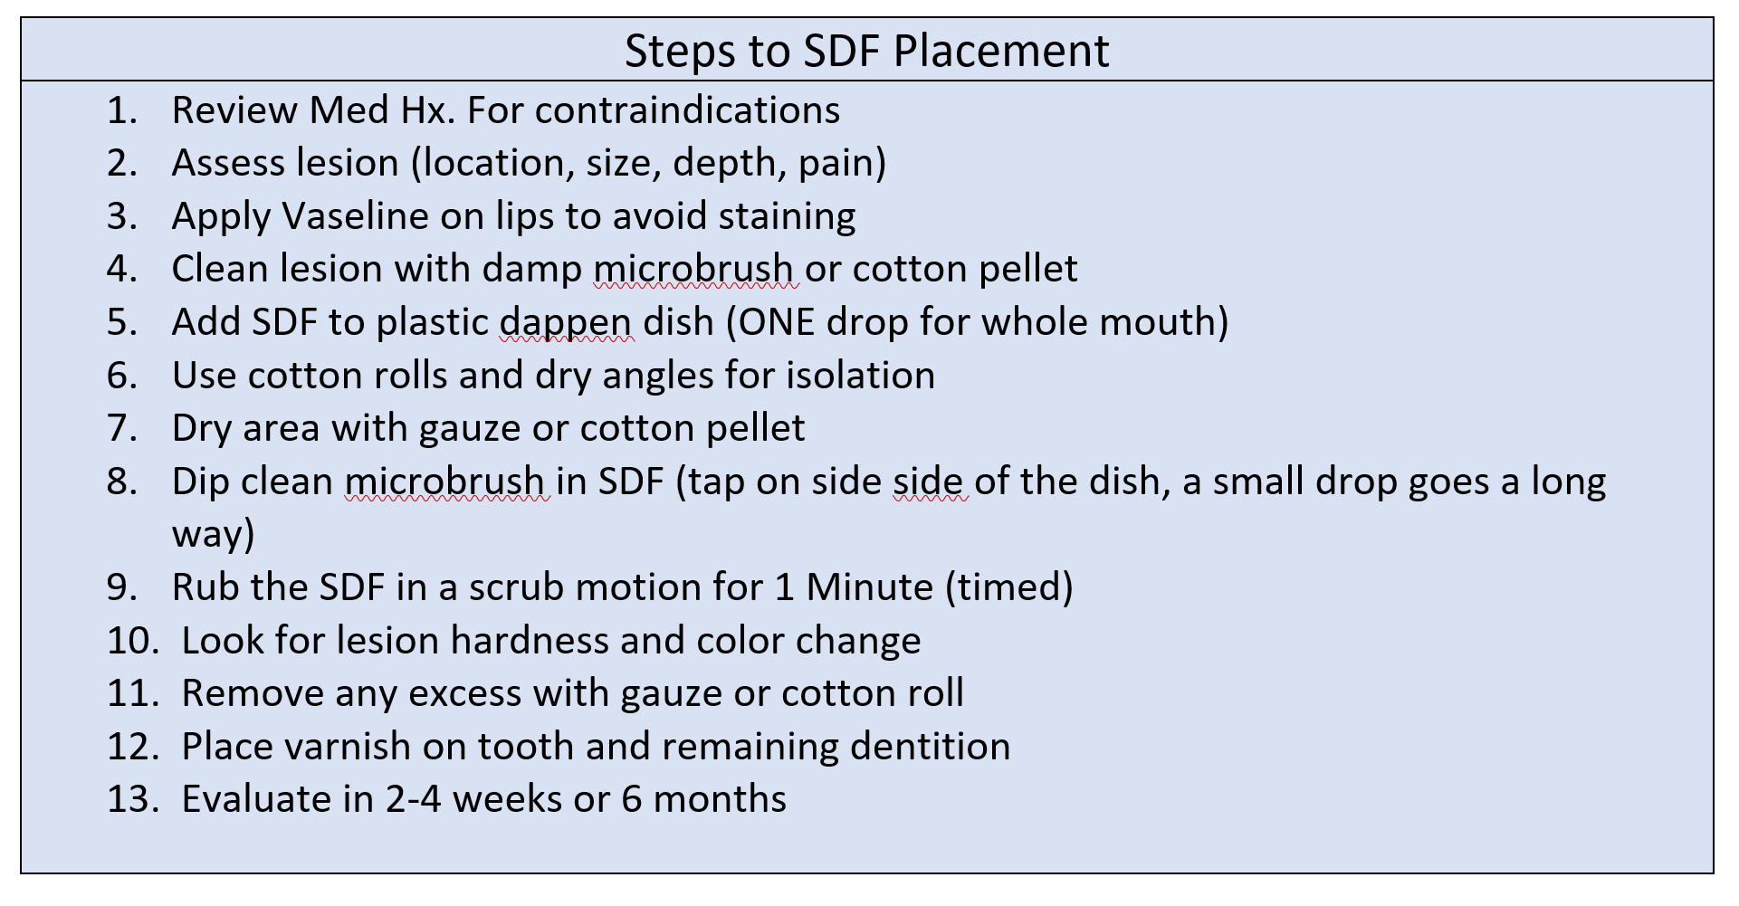
Station # 5
Steps of SDF Placement
Instructions to Faculty
Monitor students working on station #5. Use Step List as a guide. A grading rubric is to be used to evaluate students’ written response.

Slide 33
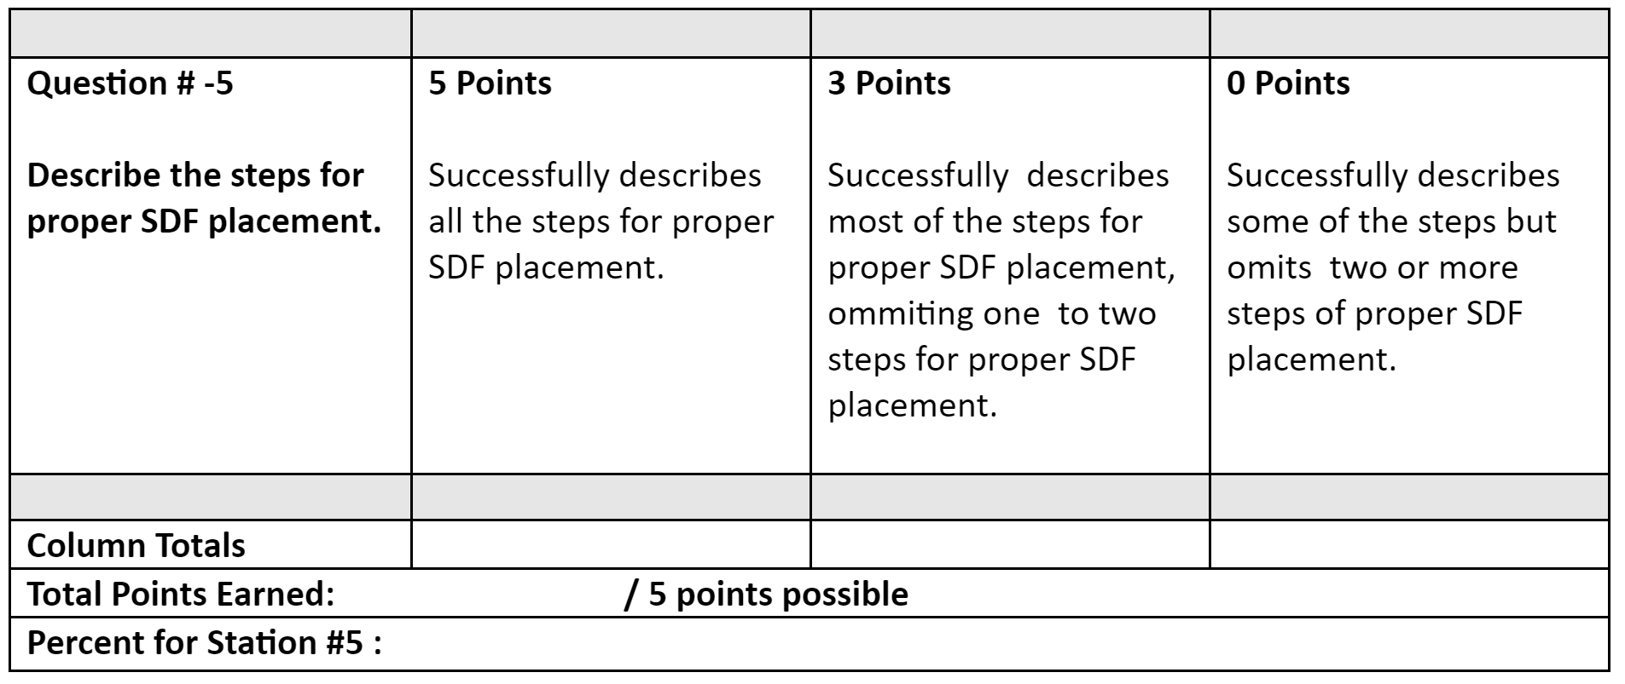
Instructions to Faculty: Circle the score for each row that best aligns with student’s response, add up the
points for each column, add all for the final score, and divide by total number of points possible. Pass=75%
Station #5 -
Steps of SDF Placement
Grading Rubric

Slide 34
Carefully read the information presented for this station and then answer the one question presented at this station. Always be mindful that you will have 5 minutes to complete this station.
Investigate and describe successful applications of SDF?
Station # 6-
Assess Proper SDF Placement
Instructions to the Students

Slide 35
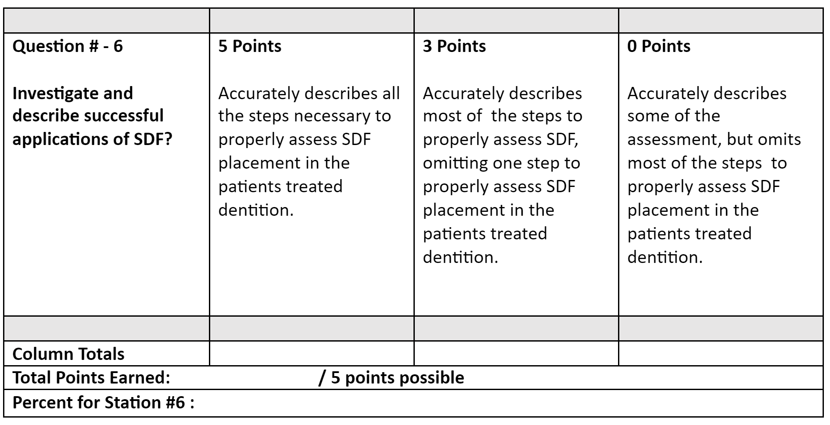
Instructions to Faculty: Circle the score for each row that best aligns with student’s response, add up the
points for each column, add all for the final score, and divide by total number of points possible. Pass=75%
Station #6 -
Assess Proper SDF Placement
Grading Rubric

Slide 36
Carefully read the information presented for this station and then answer the one question presented at this station. Always be mindful that you will have 5 minutes to complete this station.
Explain the evaluation criteria of SDF at recare?
Station # 7 -
Evaluating SDF at Recare
Instructions to the Students

Slide 37
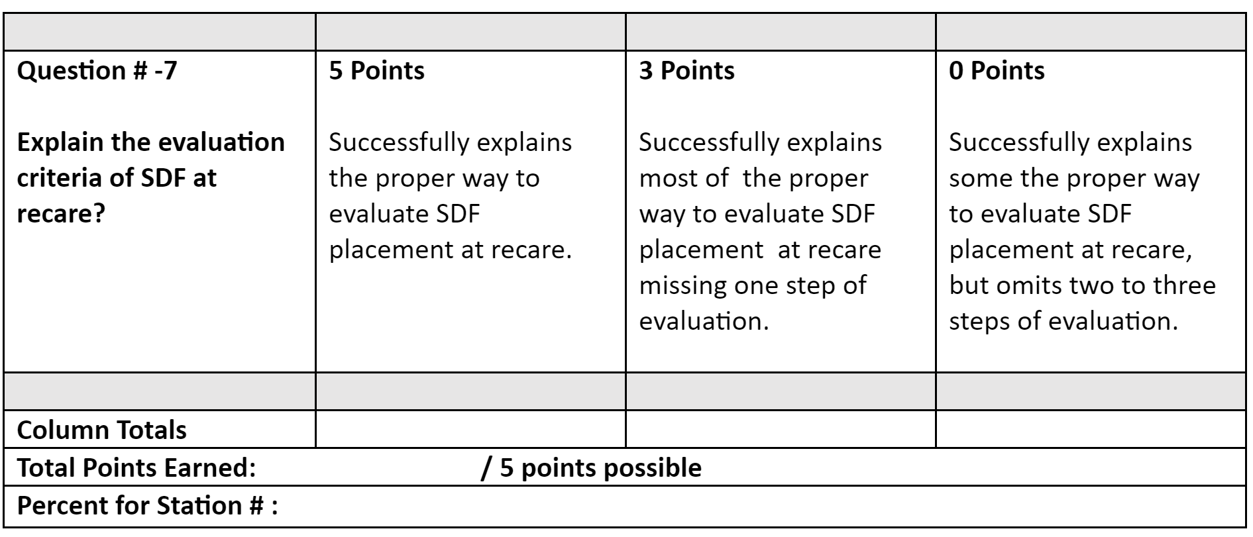
Instructions to Faculty: Circle the score for each row that best aligns with student’s response, add up the
points for each column, add all for the final score, and divide by total number of points possible. Pass=75%
Station #7 -
Evaluating SDF at Recare
Grading Rubric

Slide 38
Carefully read the information presented for this station and then answer the one question presented at this station. Always be mindful that you will have 5 minutes to complete this station.
Present two different ways of behavior management on an
anxious child.
Station # 8 -
Behavior Management
Instructions to the Students

Slide 39
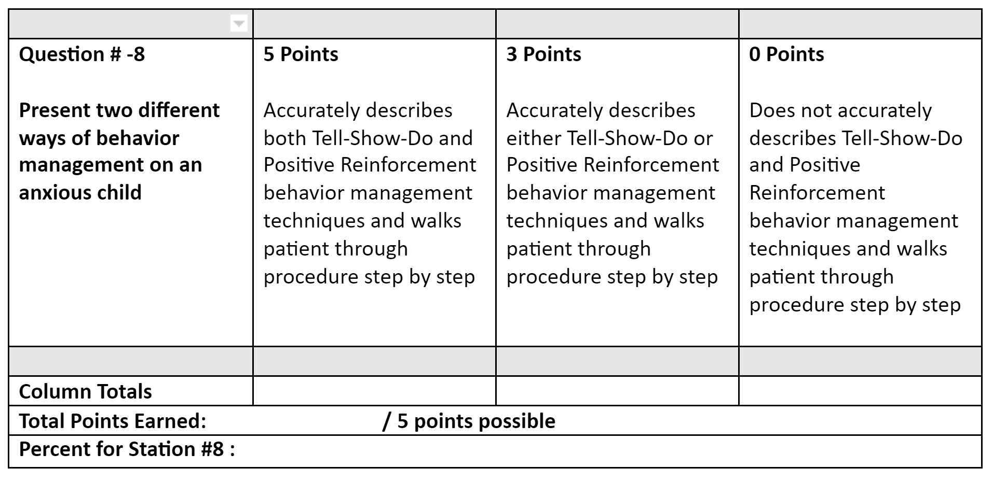
Instructions to Faculty: Circle the score for each row that best aligns with student’s response, add up the
points for each column, add all for the final score, and divide by total number of points possible. Pass=75%
Station #8 -
Behavior Management
Grading Rubric

Slide 40
OSCE Evaluation: Examples
Student Performance
Class Performance
Curriculum

Slide 41
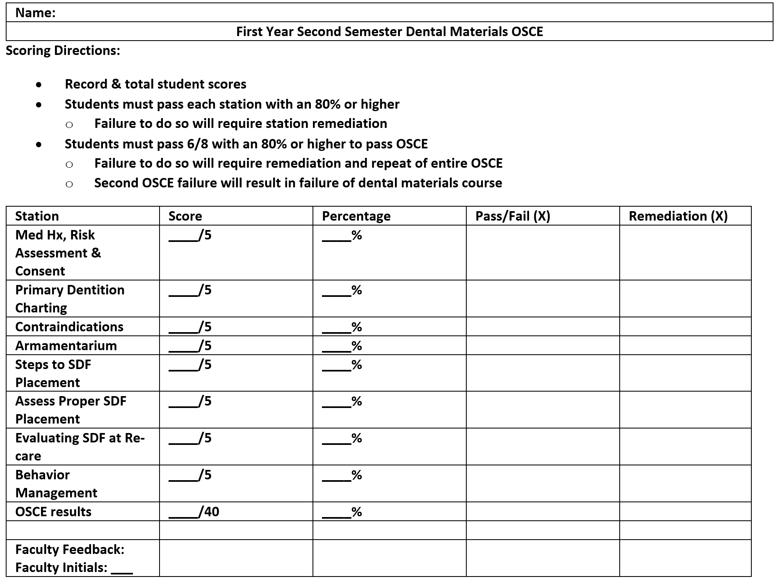
OSCE Evaluation
Student Performance

Slide 42
OSCE Evaluation
Class Performance
Class Assessment Directions: Record class average scores & percentages. Record frequency of pass, failure, & remediation rates.
Station | Average | Average % | Total Pass | Total Fail | Total Remediations
Medical History | _____/5 | _____%
Primary Dentition | _____/5 | _____%
Contraindications | _____/5 | _____%
Armamentarium | _____/5 | _____%
Steps to SDF | _____/5 | _____%
Assess SDF Evaluating SDF Behavior Man | _____/5 _____/5 _____/5 | _____% _____% _____%
OSCE Results: | ____/40 | _____%

Slide 43
OSCE Evaluation
Curriculum
Based on student performance:
Did the OSCE identify any curriculum strengths?
Did the OSCE identify any potential curriculum weaknesses?
Plans to modify curriculum based on OSCE results?

