Slide 1

OSCE TITLE
School Logo

Slide 2
MEET THE EDUCATORS

Slide 3
OVERVIEW OF CONTENT

Slide 4
Target Population

Slide 5
Example:
First year dental hygiene students with only preclinical experience.
Target Population

Slide 6
CODA Standards

Slide 7
CODA STANDARDS

Slide 8
OSCE Blueprint
EXAMPLE : SEE NEXT SLIDE

Slide 9
Station One: Floss Threader (10 points) Examiner observed Uncut – satin floss Tuft Floss Floss threader Floss holder Orthodontic typodont Chair mount Hand sanitizer Gloves Faculty directions Faculty checklist Student directions – written CODA Standard: 2-8 (c) OSCE Objective & Performance Criteria: Demonstrate biofilm removal from proximal tooth surfaces and achieve a score of 80% or above Clinical Skill Learning Domain: Psychomotor / Cognitive | Station Two: End-Tuft Brush (10 points) Examiner observed Typodont End-tuft brush Mouth mirror PPE Faculty directions Faculty checklist Student directions – written CODA Standard: 2-8 (c) OSCE Objective & Performance Criteria: Demonstrate biofilm removal from proximal tooth surfaces and achieve a score of 80% or above Clinical Skill Learning Domain: Psychomotor / Cognitive | Station Three: Blood Pressure (10 points) Examiner observed Standardized patient Stethoscope ~ BP Cuff (X3) Cavi Wipes PPE Faculty directions Evaluation checklist Student directions – written CODA Standard: 2-13 Program Objective: Collect patient data & determine health status OSCE Objective & Performance Criteria: Perform manual blood pressure and achieve a score of 80% or above Procedural Skill Learning Domain: Psychomotor / Cognitive
Station Four: Intraoral Exam (6 points) Student directions Student form Writing utensil Faculty directions Answer key CODA Standard: 2-13 (a) (f) OSCE Objective & Performance Criteria: Recognize normal anatomy of the oral cavity Demonstrate knowledge of soft tissue findings and achieve a score of 80% or above Clinical Skill Learning Domain: Psychomotor / Cognitive | Station Five: Implant Mobility (10 points) Examiner observed Implant Typodont Chair mount Mouth mirror Single-ended perio-probe End-tuft brush Hand sanitizer Gloves Faculty directions Faculty checklist & answer key Student directions & student form CODA Standard: 2-13 (b) OSCE Objective & Performance Criteria: Express importance of dental implant assessment Demonstrate knowledge of dental implant assessment and achieve a score of 80% or above Clinical Skill Learning Domain:Psychomotor / Cognitive / Affective | Station Six: Radiograph Mounting (10 points) Student directions Empty FMX mount X6 18 FMX radiographs (loose) X6 Student form Writing utensil Faculty directions Faculty checklist CODA Standard: 2-8(c) OSCE Objective & Performance Criteria: Organize radiographs and achieve a score of 80% or above Procedural Skill Learning Domain: Psychomotor / Cognitive
Station Blueprint
Station Time:
Five Minutes

Slide 10
OSCE Map
SEE EXAMPLE ON NEXT SLIDE

Slide 11
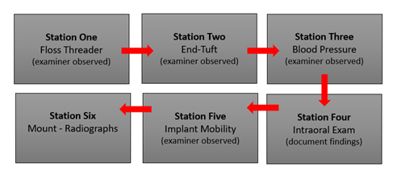
OSCE Map

Slide 12
OSCE Stations

Slide 13
There are 3 slides assigned to each station to facilitate the provision of the following information:
Slide #1: Instructions to the students; what is being required of them at the station.
Slide #2: Instructions to the faculty on what supplies, equipment and/or patient type (e.g. typodonts, simulation manikins, students as mock patients, standardized patient) needed at the station.
Slide #3: Provide the grading rubric for the station.
Template Completion Guidance

Slide 14
Slide #1: Instructions to the students including photos as needed.
Add additional slides as needed.
Station #3 - Title

Slide 15
Slide #2: Instructions to the faculty on what supplies, equipment and/or patient type (e.g. typodonts, simulation manikins, students as mock patients, standardized patients) are needed at the station.
Add additional slides as needed.
Station #1 - Title

Slide 16
Slide #3: Provide the grading rubric for the station.
Station #1 - Title

Slide 17
Slide #1: Instructions to the students including photos as needed.
Add additional slides as needed.
Station #2 - Title

Slide 18
Slide #2: Instructions to the faculty on what supplies, equipment and/or patient type (e.g. typodonts, simulation manikins, students as mock patients, standardized patient) are needed at the station.
Add additional slides as needed.
Station #2 - Title

Slide 19
Slide #3: Provide the grading rubric for the station.
Station #2 - Title

Slide 20
Slide #1: Instructions to the students including photos as needed.
Add additional slides as needed.
Station #3 - Title

Slide 21
Slide #2: Instructions to the faculty on what supplies, equipment and/or patient type (e.g. typodonts, simulation manikins, students as mock patients, standardized patient) are needed at the station.
Add additional slides as needed.
Station #3 - Title

Slide 22
Slide #3: Provide the grading rubric for the station.
Station #3 - Title

Slide 23
Continue to add slides as needed
to complete the OSCE.

Slide 24
Faculty OSCE Evaluation: Examples
Student Performance
Class Performance
Curriculum

Slide 25
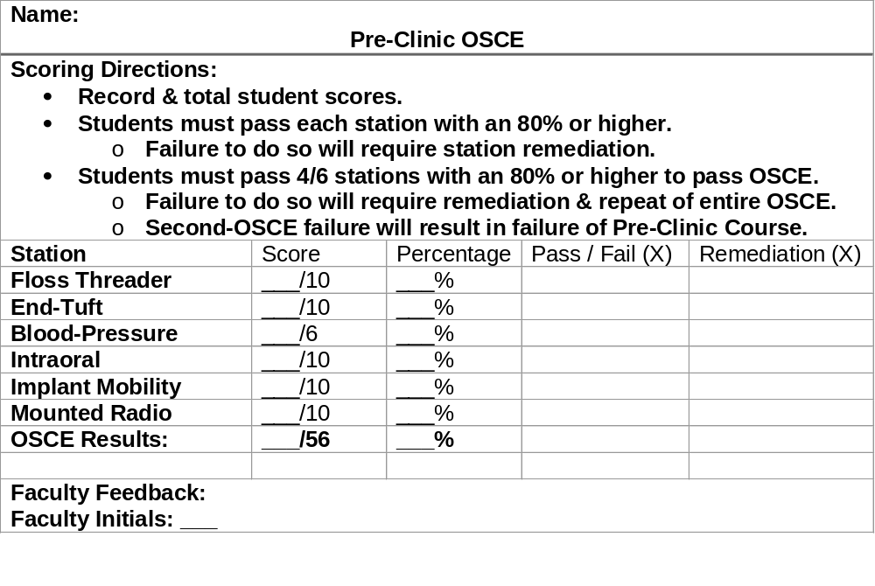
OSCE Evaluation
Student Performance

Slide 26
OSCE Evaluation
Class Performance
Class Assessment Directions: Record class average scores & percentages. Record frequency of pass, failure, & remediation rates.
Station | Average | Average % | Total Pass | Total Fail | Total Remediations
Floss Threader | _____/10 | _____%
End-Tuft | _____/10 | _____%
Blood-Pressure | _____/6 | _____%
Intraoral | ____/10 | _____%
Implant Mobility | ____/10 | _____%
Mounted Radio | ____/10 | _____%
OSCE Results: | ____/56 | _____%

Slide 27
OSCE Evaluation
Curriculum
Based on student performance:
Did the OSCE identify any curriculum strengths?
Did the OSCE identify any potential curriculum weaknesses?
Plans to modify curriculum based on OSCE results?

