Slide 1


Pre-Clinic OSCE

Slide 2
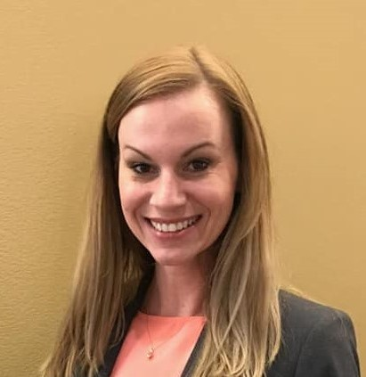
MEET THE EDUCATORS
Valerie Nieto, RDH, MS
University of Michigan
School of Dentistry
Department of Periodontics and Oral Medicine
Division of Dental Hygiene
Clinical Lecture
Undergraduate & Graduate Programs
Senior-Class Clinical Coordinator

Slide 3
OVERVIEW OF CONTENT
Target Population
CODA Standards
Blueprint
    Staff – Equipment - Supplies
Station Topic
      Evaluation Tool Type
      Directions
      CODA Standard
      Objectives & grading criteria
      Learning Domain
4. OSCE Map
5. Stations
Student Directions / Question
Faculty Directions / Evaluation Tool
6. OSCE Evaluation

Slide 4
Target Population

Slide 5
Pre-Clinic
First - year dental hygiene students

Slide 6
CODA Standards

Slide 7
2-8 (b) Dental hygiene science content must include oral health education and preventive counseling, health promotion, patient management, clinical dental hygiene, provision of services for and management of patients with special needs, community dental/oral health, medical and dental emergencies, legal and ethical aspects of dental hygiene practice, infection and hazard control management, and the provision of oral health care services to patients with bloodborne infectious diseases; (c ) Dental sciences content must include tooth morphology, head, neck and oral anatomy, oral embryology and histology, oral pathology, radiography, periodontology, pain management, and dental materials
2-13 Graduates must be competent in providing the dental hygiene process of care which includes: (a) comprehensive collection of patient data to identify the physical and oral health status; (b) analysis of assessment findings and use of critical thinking in order to address the patient’s dental hygiene treatment needs; (f) complete and accurate recording of all documentation relevant to patient care
CODA STANDARDS

Slide 8
OSCE Blueprint

Slide 9
Station One: Floss Threader (10 points) Examiner observed Uncut – satin floss Tuft Floss Floss threader Floss holder Orthodontic typodont Chair mount Cavi Wipes PPE Student directions – written Faculty directions Faculty checklist CODA Standard: 2-8 (c) OSCE Objective & Performance Criteria: Demonstrate biofilm removal from proximal tooth surfaces and achieve a score of 80% or above Clinical Skill: Psychomotor / Cognitive | Station Two: End-Tuft Brush (10 points) Examiner observed Typodont End-tuft brush Mouth mirror Cavi Wipes PPE Student directions – written Faculty directions Faculty checklist CODA Standard: 2-8 (c) OSCE Objective & Performance Criteria: Demonstrate biofilm removal from proximal tooth surfaces and achieve a score of 80% or above Clinical Skill: Psychomotor / Cognitive | Station Three: Blood Pressure (10 points) Examiner observed Standardized patient Stethoscope ~ BP Cuff (X3) Cavi Wipes PPE Student directions – written Faculty directions Evaluation checklist CODA Standard: 2-13 Program Objective: Collect patient data & determine health status OSCE Objective & Performance Criteria: Perform manual blood pressure and achieve a score of 80% or above Procedural Skill: Psychomotor / Cognitive
Station Four: Intraoral Exam (6 points) Cavi Wipes PPE Student directions Student form Writing utensil Faculty directions Answer key CODA Standard: 2-13 (a) (f) OSCE Objective & Performance Criteria: Recognize normal anatomy of the oral cavity Demonstrate knowledge of soft tissue findings and achieve a score of 80% or above Clinical Skill: Psychomotor / Cognitive | Station Five: Implant Mobility (10 points) Examiner observed Implant Typodont Chair mount Mouth mirror Single-ended perio-probe End-tuft brush Cavi Wipes PPE Student directions & student form Faculty directions Faculty checklist & answer key CODA Standard: 2-13 (b) OSCE Objective & Performance Criteria: Express importance of dental implant assessment Demonstrate knowledge of dental implant assessment and achieve a score of 80% or above Clinical Skill: Psychomotor / Cognitive / Affective | Station Six: Radiograph Mounting (10 points) Student directions Empty FMX mount X6 18 FMX radiographs (loose) X6 Cavi Wipes PPE Student form Writing utensil Faculty directions Faculty checklist CODA Standard: 2-8(c) OSCE Objective & Performance Criteria: Organize radiographs and achieve a score of 80% or above Procedural Skill: Psychomotor / Cognitive
Station Blueprint
Station Time:
Five Minutes

Slide 10
OSCE Map

Slide 11
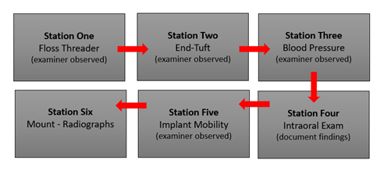
OSCE Map

Slide 12
OSCE Stations

Slide 13
Station One
Floss Threader

Slide 14
Station One: Floss Threader
Student Directions
Written directions located on station countertop
Instructor Evaluation Tool
Checklist
Points Possible: 10
Supplies
Uncut – satin dental floss
Tuft floss
Floss threader
Floss holder
Orthodontic typodont
Chair mount
Hand sanitizer
Gloves

Slide 15
Use a floss threader to floss interproximal surfaces #8 - #9 superior to the wire on the orthodontic typodont provided.
Station One: Floss Threader
Student Directions

Slide 16
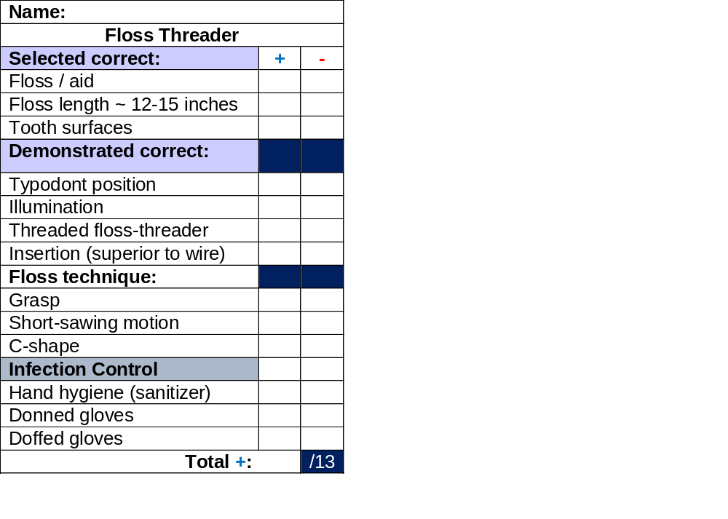
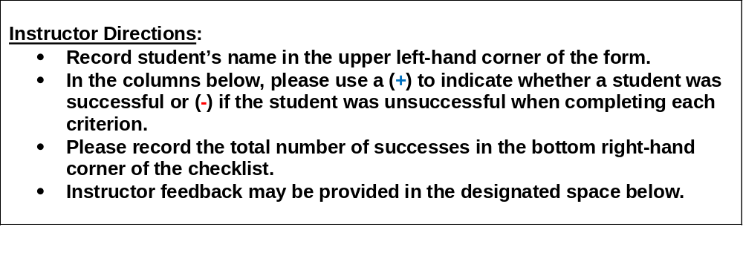
Station One: Floss Threader
Instructor Directions & Evaluation Tool
Instructor Feedback:

Slide 17
Station Two
End-Tuft Brush

Slide 18
Station Two: End Tuft
Student Directions
Written directions located on station countertop
Instructor Evaluation Tool
Checklist
Possible Points: 10
Supplies
Single-tuft brush
Mouth mirror
Typodont
  Missing #18
Chair mount
Hand sanitizer
Gloves

Slide 19
Assess the typodont
Identify an open interproximal area
Verbalize area to instructor
Use the End-Tuft Brush to demonstrate sulcular brushing technique
Station Two: End Tuft Brush
Student Directions

Slide 20

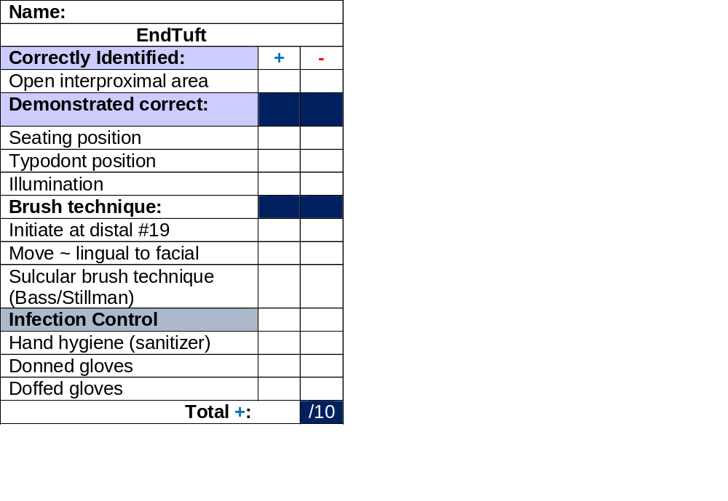
Station Two: End Tuft Brush
Instructor Directions & Evaluation Tool
Instructor Feedback:

Slide 21
Station Three
Blood Pressure

Slide 22
Station Three: Manual Blood Pressure
Student Directions
Written directions located on station countertop
Instructor Evaluation Tool
Checklist
Points Possible: 10
Supplies
Standardized Patient (SP)
Blood Pressure Cuffs
  Extra Large – Regular - Pediatric
Stethoscope
Cavi-Wipes
Hand sanitizer
Gloves
Level-3 mask (student & SP)

Slide 23
Station Three: Blood Pressure
Student Directions
Please select the appropriate blood pressure cuff.
Acquire a manual blood pressure reading.

Slide 24
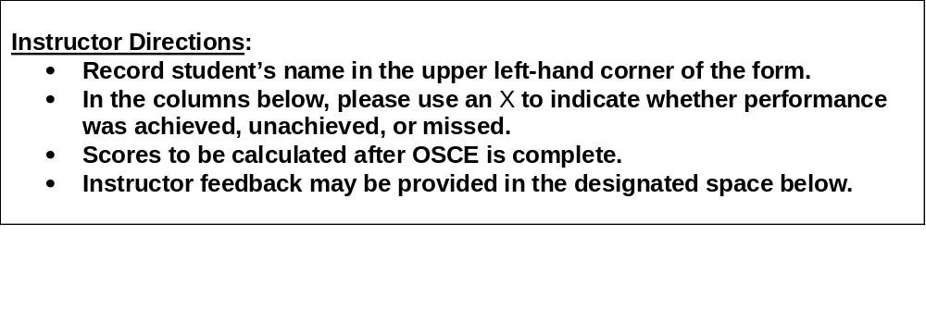
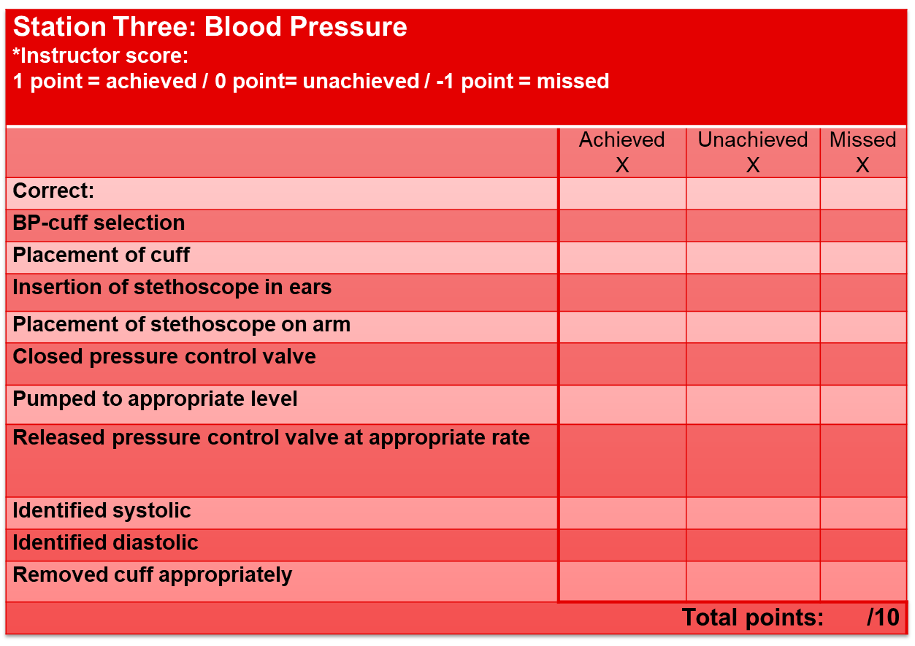
Station Three: Blood Pressure
Instructor Directions & Evaluation Tool
Instructor Feedback:

Slide 25
Station Four
Intra-Oral Exam

Slide 26
Station Four: Intraoral Exam
Student Directions
Written directions located on station countertop
Faculty Evaluation Tool
Answer-Key
Points Possible: 6
Supplies
Intraoral Image
Student Form
Writing utensil

Slide 27
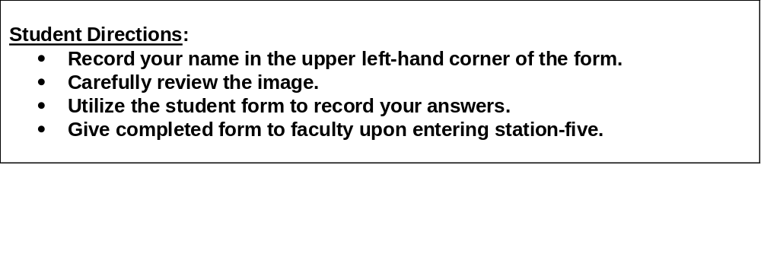
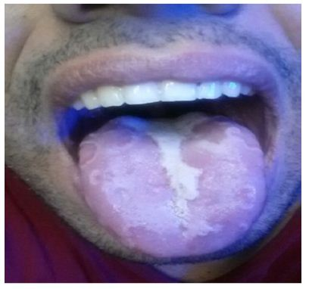
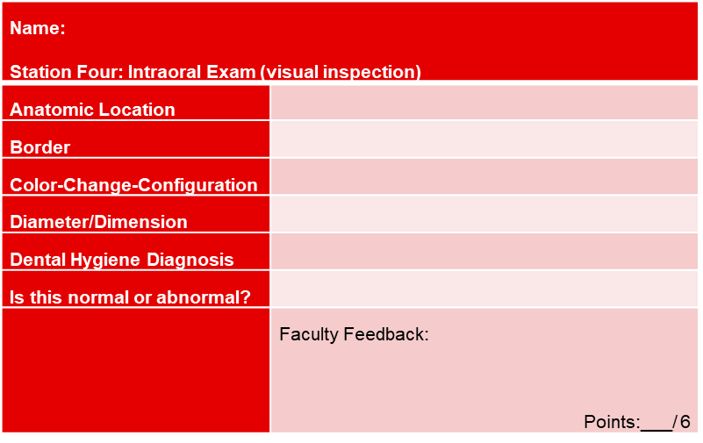
Station Four – Intraoral Exam
Student Directions & Exam Tools

Slide 28
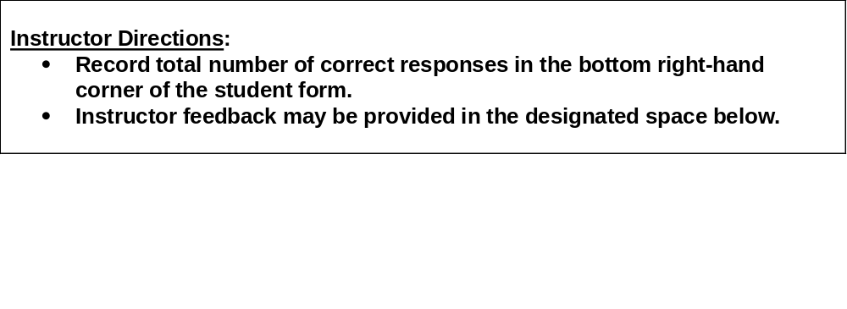
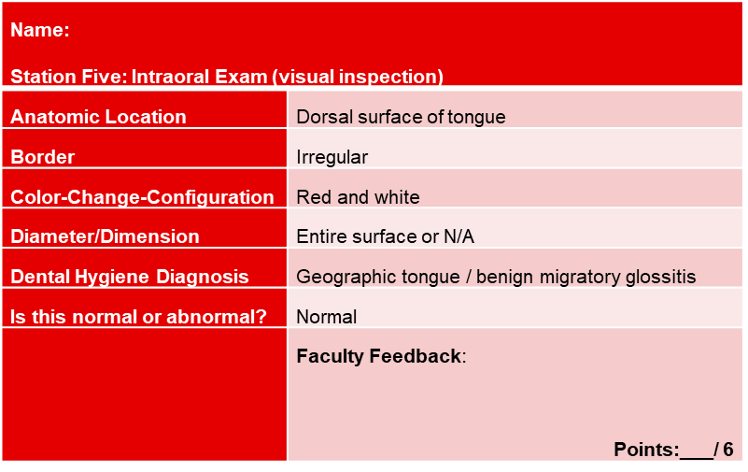
Station Four – Intraoral Exam
Instructor Directions & Answer Key

Slide 29
Station Five
Implant Mobility

Slide 30
Station Five – Implant Mobility
Student Directions
Written directions located on station countertop
Faculty Evaluation Tool
Checklist (8 points)
Answer Key (2 points)
Points Possible: 10
Supplies
Typodont w/ implant
Chair mount
Mouth mirror
Single-ended perio-probe
Student form
Writing utensil

Slide 31
Station Five: Implant Mobility
Student Directions & Student Form
Assess the dental implant for mobility.
Complete student form.
Name: Station Five: Implant Mobility
Why is it important to assess dental implants for mobility? (1 point)
If mobility is observed, why is it important to capture a radiograph? (1 point)
Points:___/2

Slide 32
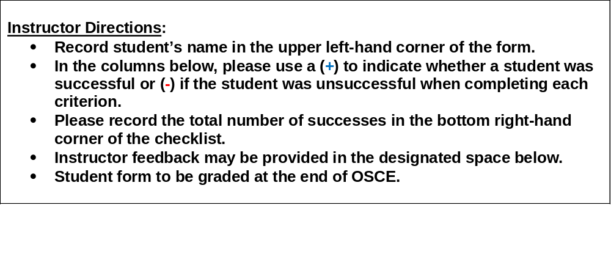
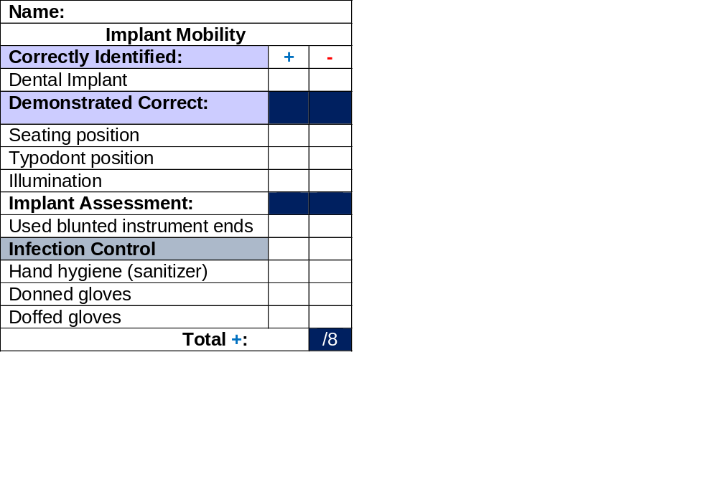
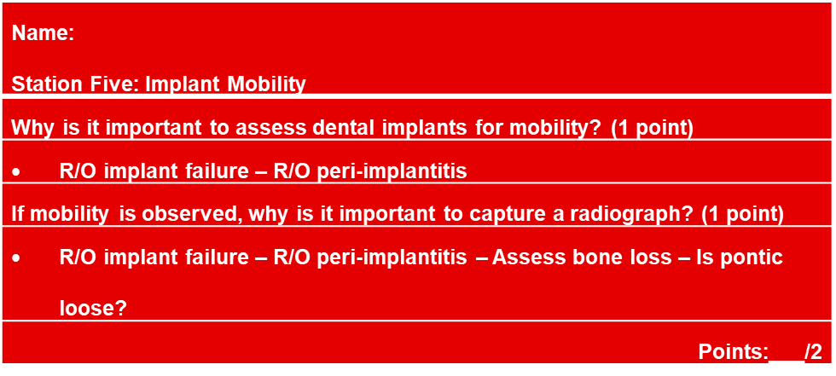
Station Five: Implant Mobility
Instructor Directions - Evaluation Tool – Answer Key
Instructor Feedback:

Slide 33
Station Six
Mounted Radiographs

Slide 34
Station Six: Mounted Radiographs
Student Directions
Written directions located on station countertop
Faculty Evaluation Tool
Checklist
Points Possible: 10
Supplies
Empty FMX mount
18 loose radiographs

Slide 35
Station Six: Mounted Radiographs
Student Directions
Accurately mount the loose FMX radiographs into the empty mount.

Slide 36
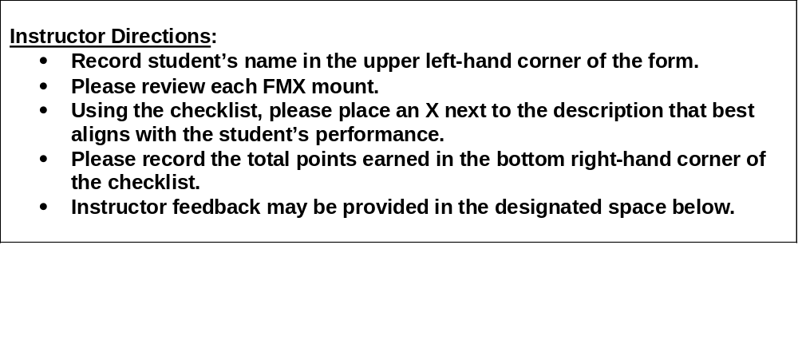
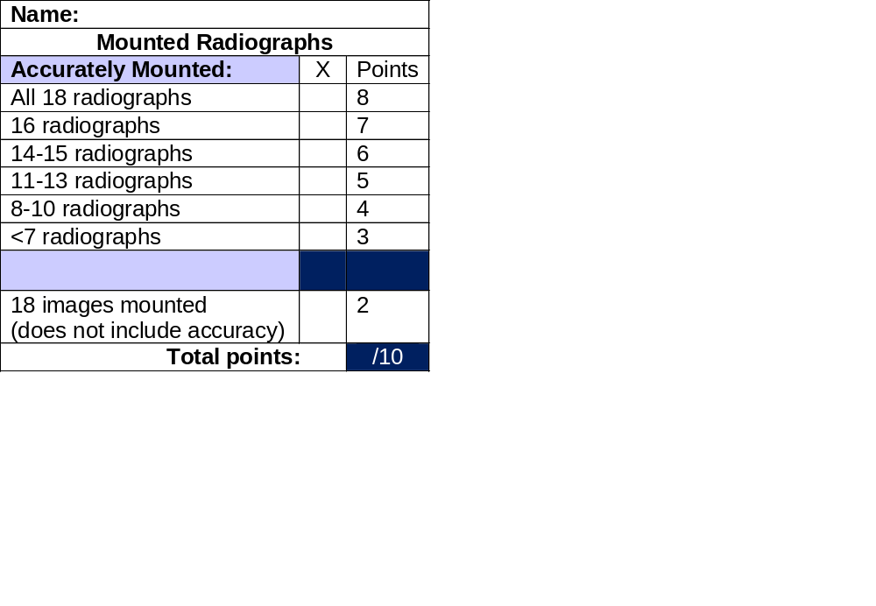
Station Six: Mounted Radiographs
Instructor Directions - Evaluation Tool
Instructor Feedback:

Slide 37
Faculty OSCE Evaluation
Student Performance
Class Performance
Curriculum

Slide 38
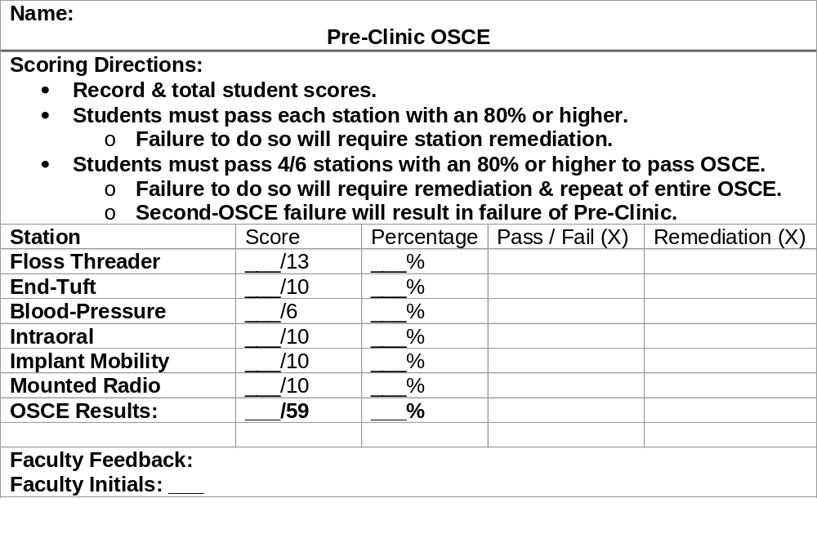
OSCE Evaluation
Student Performance

Slide 39
OSCE Evaluation
Class Performance
Class Assessment Directions: Record class average scores & percentages. Record frequency of pass, failure, & remediation rates.
Station | Average | Average % | Total Pass | Total Fail | Total Remediations
Floss Threader | _____/13 | _____%
End-Tuft | _____/10 | _____%
Blood-Pressure | _____/6 | _____%
Intraoral | ____/10 | _____%
Implant Mobility | ____/10 | _____%
Mounted Radio | ____/10 | _____%
OSCE Results: | ____/59 | _____%

Slide 40
OSCE Evaluation
Curriculum
Based on student performance:
Did the OSCE identify any curriculum strengths?
Did the OSCE identify any potential curriculum weaknesses?
Plans to modify curriculum based on OSCE results?

Slide 41
The End

