Slide 1


Objective Structured Clinical Examination (OSCE)
Sealants

Slide 2

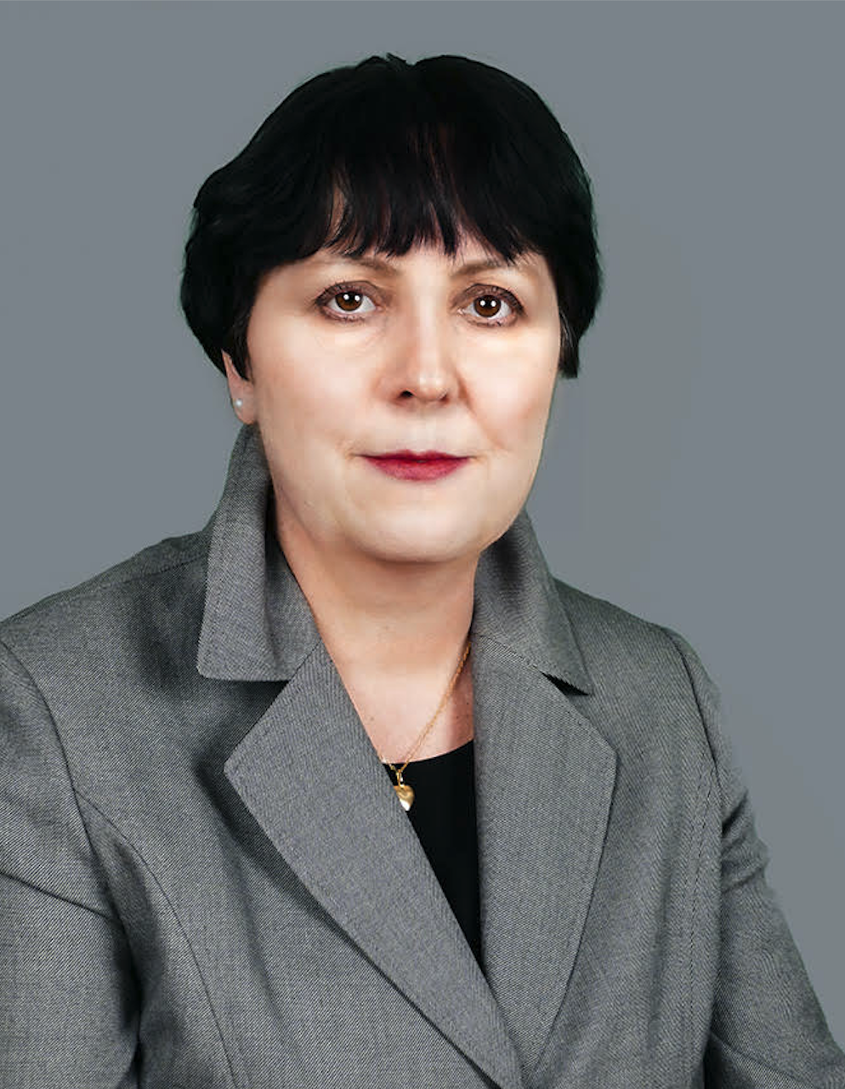
MEET THE EDUCATORS
Kim Attanasi, PhD, MS, RDH
Aleksandra Czaplinska, BEd, BS, RDH

Slide 3
Overview of Content
Dental Anatomy
Principles of Dental Hygiene 1
Lecture and Clinic

Slide 4
First year, second semester dental hygiene students in a virtual or face-to-face setting.
Target Population

Slide 5
Standard 2 – Educational Program
2-8a
2-8c
2-8d
2-12
2-13
2-15
2-18
2-19
2-21
2-23
CODA Standards

Slide 6
Presentation Format Overview
This is a timed OSCE where students rotate through stations either virtual or in a face-to-face environment. Students will be allowed 5 minutes per station to answer questions presented at each station.
See OSCE instructions in the resource section for additional information.

Slide 7
Software and Equipment Requirements
For Virtual Format
Microsoft PowerPoint or Google Slides
Internet connection with broadband of 3G or faster
Computer, laptop, tablet or iPad
LMS Platform supported by your institution
Highly recommended is the utilization of lockdown services, proctoring of exam via Zoom, or other security measures available with your LMS platform.

Slide 8
Equipment Requirements
For Face-to-Face Format
A room or space that will allow for 7 independent stations.
Each station will need a computer with Internet access, an area where students can sit to read each station’s information and respond to questions.
LMS Platform, supported by your institution, if students will be answering question directly into a software program OR hard copy answer sheets.

Slide 9
Instructions to Students
This OSCE focuses on sealants placement. You have 10 minutes to review the OSCE. Once 10 minutes are up, you will move forward to your first assigned station.

Slide 10
Station #1
History Taking and Risk Assessment

Slide 11
Carefully read the information presented for this station and then answer the one question presented at this station.
Always be mindful that you will have 5 minutes to complete this station.
Station #1
History Taking and Risk Assessment
Instructions to Students

Slide 12
Station #1
History Taking and Risk Assessment
Scenario
While reviewing the health history with your patient, you identify behaviors that place the patient into a high caries risk.

Slide 13
Station #1
History Taking and Risk Assessment
Question #1
Provide the indications for treatment planning sealants.

Slide 14
Station #1
History Taking and Risk Assessment
Instructions to Faculty
Monitor students working on station #1. A grading rubric is to be used to evaluate students’ written responses.

Slide 15
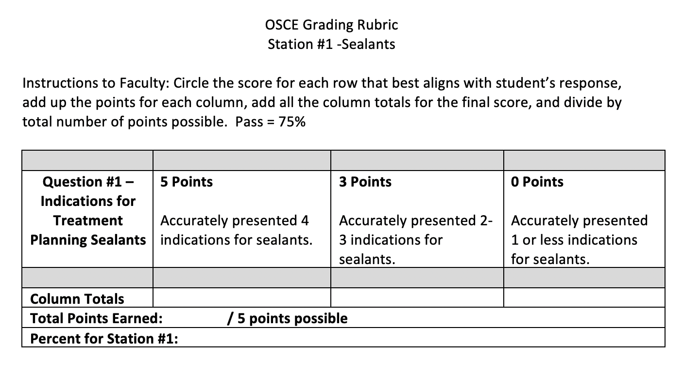
Station #1
History Taking and Risk Assessment
Grading Rubric

Slide 16

Station #2 -
Tooth Anatomy

Slide 17
Carefully read the information presented at this station and answer
the one question associated with this station.
Always be mindful that you will have 5 minutes to complete this station.
Station #2 -
Tooth Anatomy
Instructions to Students

Slide 18
You are scheduled to place sealants to day on your 1:00 patient.
Station #2 -
Tooth Anatomy
Scenario

Slide 19
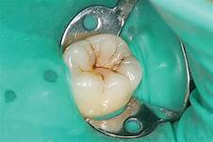
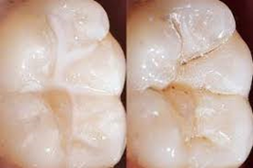
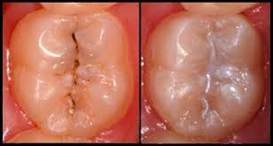
Based on traditional dental anatomy of tooth #19, what surfaces would you seal?
Station #2 -
Tooth Anatomy
Question #1

Slide 20
Monitor students working on station #2. Grading rubric is to be used to evaluate students’ written responses.
Station #2 -
Tooth Anatomy
Instructions to Faculty

Slide 21
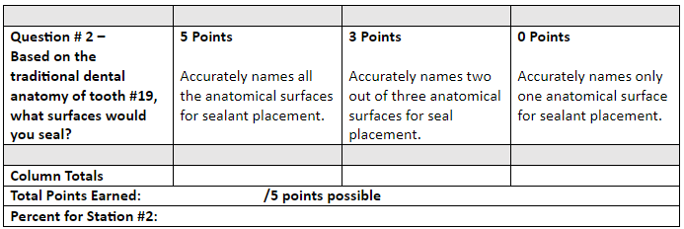
OSCE Grading Rubric
Station #2- Sealants
Instructions to Faculty: Circle the score for each row that best aligns with student’s response, add up the points for each column, add all for the final score, and divide by total number of points possible. Pass=75%
Station #2
Tooth Anatomy
Grading Rubric

Slide 22
Station #3
Application and Armamentarium

Slide 23
Station #3
Application and Armamentarium
Instructions to Students
Carefully read the information presented at this station and answer the one question associated with this station.
Always be mindful that you will have 5 minutes to complete this station.

Slide 24
Station #3
Application and Armamentarium
Scenario
You are fortunate enough to have a pre-dental hygiene student observing you today as you place a sealant on tooth #19.

Slide 25
Station #3
Application and Armamentarium
Question #1
Describe each step of a sealant placement from start to finish using a rubber dam for isolation.

Slide 26
Monitor students working on station #3. Grading rubric is to be used to evaluate students’ written responses.
Station #3
Application and Armamentarium
Faculty Instructions

Slide 27
Station #4
Pediatric Behavior Management

Slide 28
Station #4
Pediatric Behavior Management
Instructions to Students
Carefully read the information presented at this station and answer the one question associated with this station.
Always be mindful that you will have 5 minutes to complete this station.

Slide 29
Station #4
Pediatric Behavior Management
Instructions to Students
Scenario
Today, you are placing a sealant on a 6-year old. She has been very cooperative up until now. You have the etchant in your hand and the young patient states she “doesn’t want to do” the sealant anymore.

Slide 30
Station #4
Pediatric Behavior Management
Question #1
Present 2 different ways to handle this situation.

Slide 31
Station #4
Pediatric Behavior Management
Faculty Instructions
Monitor students working on station #4. Grading rubric is to be used to evaluate students’ written responses.

Slide 32
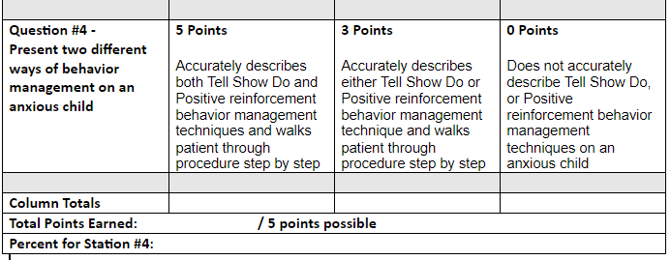
Station #4
Pediatric Behavior Management
Grading Rubric
OSCE Grading Rubric
Station #4- Sealant
Instructions to Faculty: Circle the score for each row that best aligns with student’s response, add up the points for each column, add all for the final score, and divide by total number of points possible. Pass=75%

Slide 33
Station #5
Clinical Self-Assessment
Instruction to Students
Carefully read the information presented at this station and answer the one question associated with this station.
Always be mindful that you will have 5 minutes to complete this station.

Slide 34
Upon completion of light curing the bond, you notice saliva contaminated the tooth.
Station #5
Clinical Self-Assessment
Scenario

Slide 35
What are you next steps in placing the sealant? Provide your rationale for each step.
Station #5
Clinical Self-Assessment
Question #1

Slide 36
Monitor students working on station #5. Grading rubric is to be used to evaluate students’ written responses
Station #5
Clinical Self-Assessment
Faculty Instructions

Slide 37
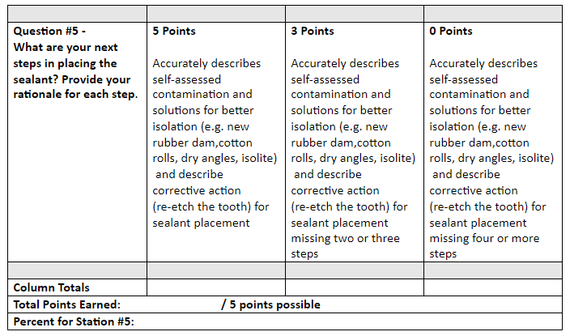
OSCE Grading Rubric
Station #5- Sealant
Instructions to Faculty: Circle the score for each row that best aligns with student’s response, add up the points for each column, add all for the final score, and divide by total number of points possible. Pass=75%
Station #5
Clinical Self-Assessment
Grading Rubric

Slide 38
Station #6
Incorporation of Evidence-Based Decision Making

Slide 39
Station #6
Incorporation of Evidence-Based Decision Making
Student Instructions
Carefully read the information presented at this station and answer the one question associated with this station.
Always be mindful that you will have 5 minutes to complete this station.

Slide 40
You are going to place sealants on the occlusal surfaces of teeth #’s15, #19 and #30.
Station #6
Incorporation of Evidence-Based Decision Making
Scenario

Slide 41
What steps can you take to improve the retention rates for these sealants? Provide the rationale for each.
Station #6
Incorporation of Evidence-Based Decision Making
Question #1

Slide 42
Monitor students working on station #6. Grading rubric is to be used to evaluate students’ written responses.
Station #6
Incorporation of Evidence-Based Decision Making
Faculty Instructions

Slide 43
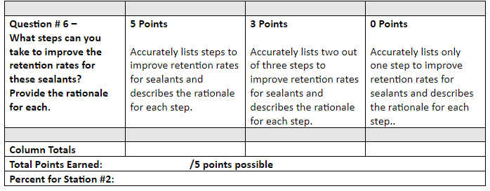
OSCE Grading Rubric
Station #6- Sealant
Instructions to Faculty: Circle the score for each row that best aligns with student’s response, add up the points for each column, add all for the final score, and divide by total number of points possible. Pass=75%
Station #6
Incorporation of Evidence-Based Decision Making
Grading Rubric

Slide 44
Station #7
Self Assessment

Slide 45
Station #7
Self Assessment
Instruction to Students
Carefully read the information presented at this station and answer the one question associated with this station.
Always be mindful that you will have 5 minutes to complete this station.

Slide 46
Station #7
Self Assessment
Scenario
You have completed the placement of sealants on teeth #15, 19 and 30. As you check the sealant retention with your explorer, you note pieces of the sealant material flicking off.

Slide 47
What are 3 common reasons for this? How would you modify your technique to address these issues?
Station #7
Self Assessment
Question #1

Slide 48
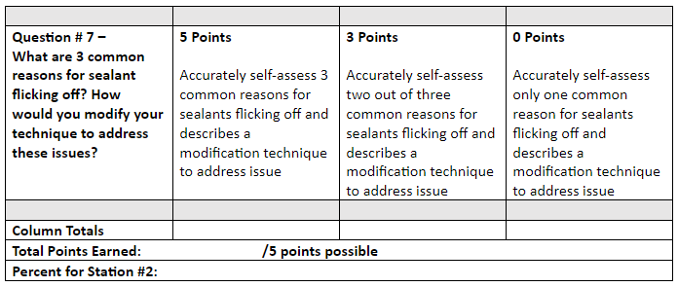
OSCE Grading Rubric
Station #7- Sealant
Instructions to Faculty: Circle the score for each row that best aligns with student’s response, add up the points for each column, add all for the final score, and divide by total number of points possible. Pass=75%
Station #7
Self Assessment
Grading Rubric

Slide 49
OSCE Evaluation
Curriculum
Based on student performance:
Did the OSCE identify any curriculum strengths?
Did the OSCE identify any potential curriculum weaknesses?
Plans to modify curriculum based on OSCE results?

