Slide 1


Objective Structured Clinical Examination (OSCE)
Special Needs Patients

Slide 2

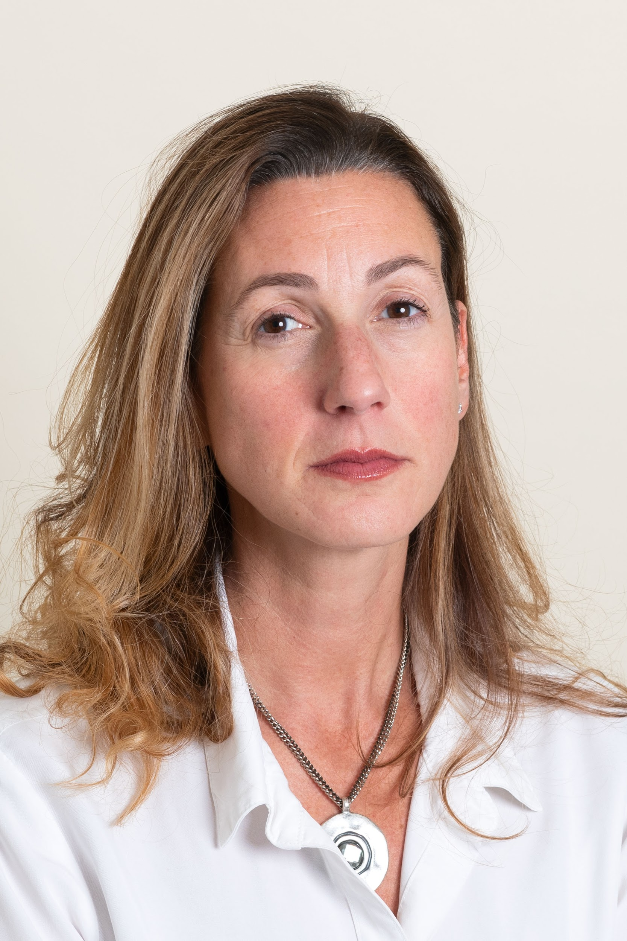
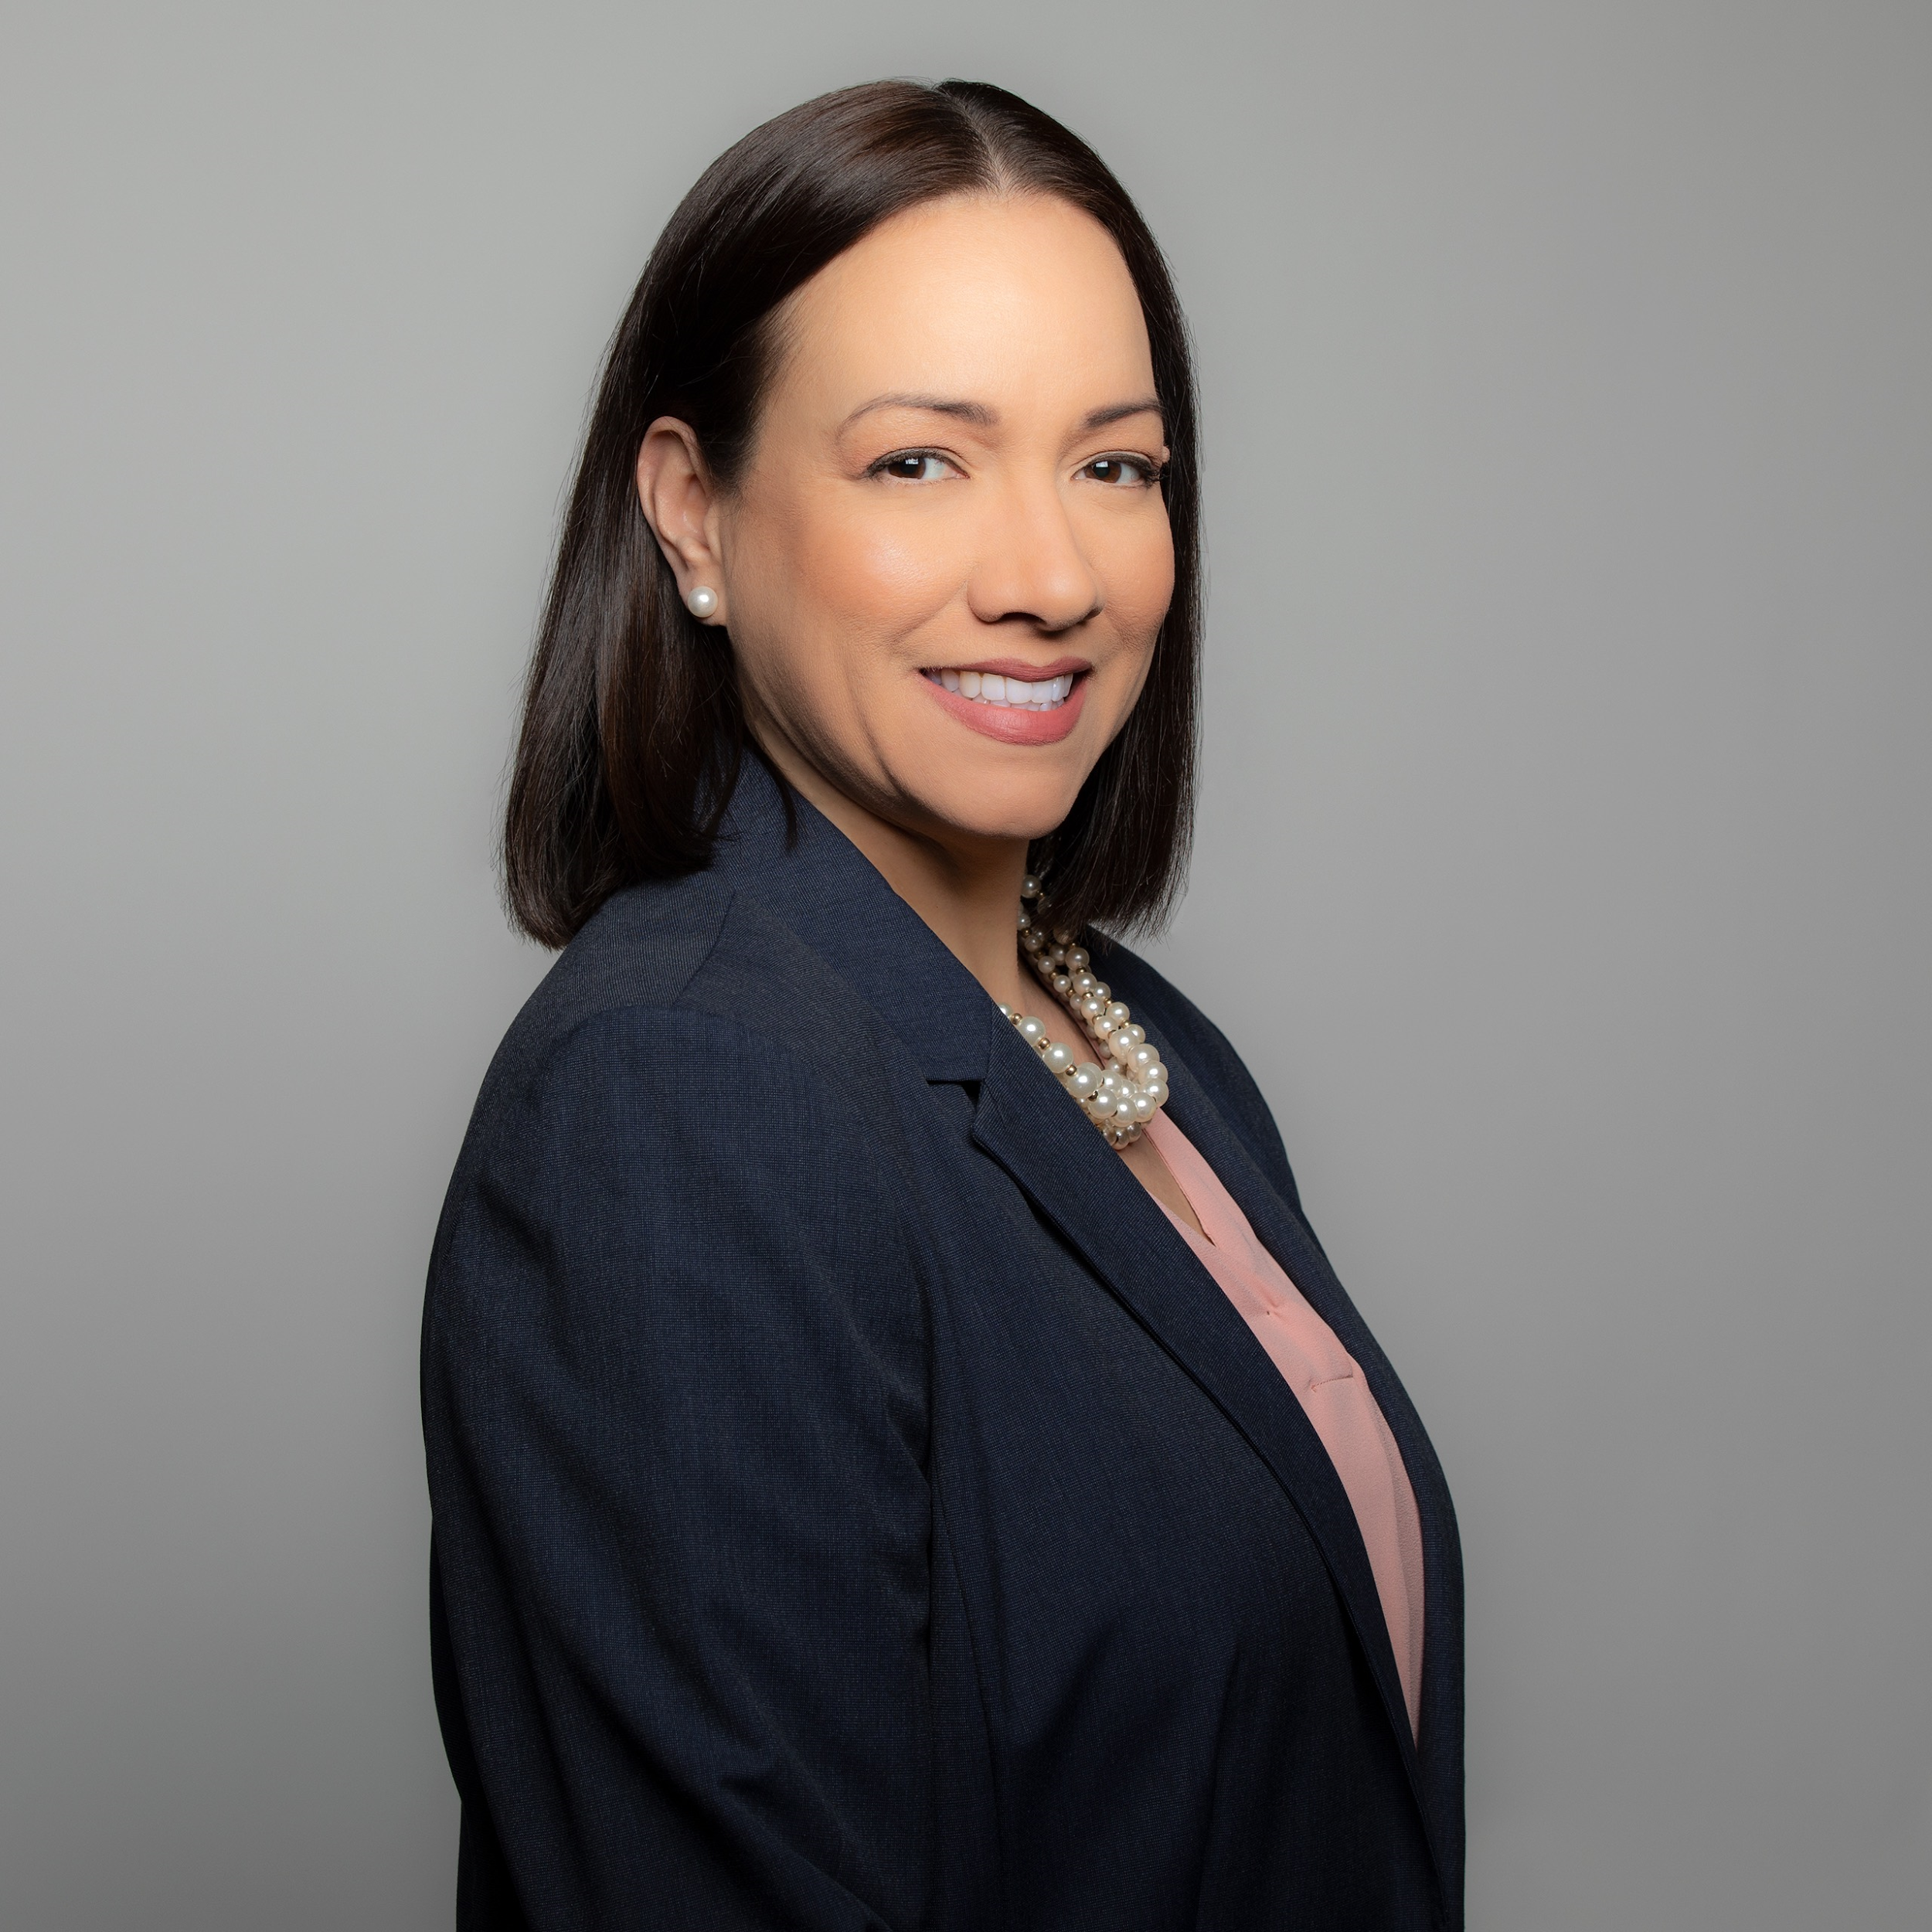
MEET THE EDUCATORS
Jean Hall, RDH, DHEd, CHES
Susan Vogell, Ed.D, RDH
Margarita Rivera, RDH, MSDH

Slide 3
Overview of Content
Treating patients with special needs, including but not limited to:
  Intellectual /developmental disabilities
  Complex medical problems
  Significant physical limitations
Includes knowledge from clinical theory, periodontology, oral pathology, nutrition, radiology and community dental/public health.

Slide 4
Second year dental hygiene students in a virtual or face-to-face setting.
Target Population

Slide 5
Standard 2 – Patient Care Competencies 2-12
Graduates must be competent in providing dental hygiene care for the child, adolescent, adult, geriatric, and special needs patient populations (CODA, 2019).
CODA Standards

Slide 6
Presentation Format Overview
This is a timed OSCE where students rotate through stations either virtual or in a face-to-face environment. Students will be allowed 10 minutes per station to answer questions presented at each station.
See OSCE instructions in the resource section for additional information.

Slide 7
Software and Equipment Requirements
For Virtual Format
Microsoft PowerPoint or Google Slides
Internet connection with broadband of 3G or faster
Computer, laptop, tablet or iPad
LMS Platform supported by your institution
Highly recommended is the utilization of lockdown services, proctoring of exam via Zoom, or other security measures available with your LMS platform.

Slide 8
Equipment Requirements
For Face-to-Face Format
A room or space that will allow for 7 independent stations.
Each station will need a computer with Internet access, an area where students can sit to read each station’s information and respond to questions.
LMS Platform, supported by your institution, if students will be answering question directly into a software program OR hard copy answer sheets.

Slide 9
Instructions to Students
This OSCE focuses on one patient, Flora. Different aspects of information about Flora’s case will be presented as you move through the OSCE. The information presented will build upon itself until you have all the information associated with the case.

Slide 10
Station #1
Introduction to Flora

Slide 11
Carefully read the information presented for the Flora scenario and then answer the two questions presented at this station.
Always be mindful that you will have 10 minutes to complete this station.
Station #1
Introduction to Flora
Instructions to Students

Slide 12
Station #1
Introduction to Flora
Scenario
Flora, a 23-year-old Hispanic female, is in your schedule for 11:00 am. After reviewing her medical history, she confides in you she is 13 weeks pregnant with her first child.
Flora has never been to the dentist and is embarrassed. She reports sensitivity to cold drinks, that her teeth on the top left side hurt, and her gums bleed when she brushes her teeth.

Slide 13
Station #1
Introduction to Flora
Scenario
Flora is in good health and has had a recent physical (less than a year) at a clinic near her home. She sees an OB-GYN at the same clinic who suggested she has a dental exam.
Flora takes 400 mcg of folic acid daily and has no allergies.
Her vitals today:
  BP: 117/78 mmHg
  Pulse: 45 beats per minute
  Respiration: 15 breaths per minute
  Temp. 97.1 ⁰ F

Slide 14
Station #1
Introduction to Flora
Question #1
Based on Flora’s medical history, what should be your next step?

Slide 15
Station #1
Introduction to Flora
Question #2
Provide Flora’s ASA classification and 2 to 3 modifications that would be appropriate during her treatment.

Slide 16
Station #1
Introduction to Flora
Instructions to Faculty
Monitor students working on station #1. A grading rubric is to be used to evaluate students’ written responses.

Slide 17
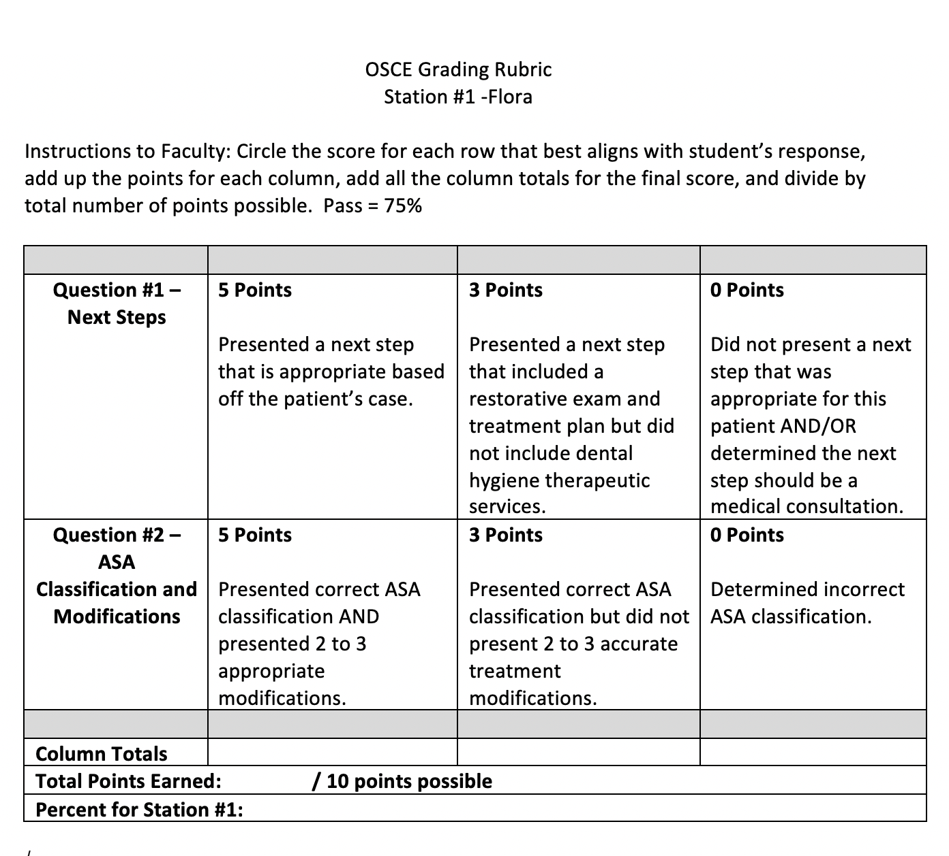
Station #1
Introduction to Flora
Grading Rubric

Slide 18
Station #2 -
Flora’s Intraoral Lesion

Slide 19
Carefully read the information presented at this station and answer the two questions associated with this station. The information presented at this station is to build on and expand the information presented at station #1.
Always be mindful that you will have 10 minutes to complete this station.
Station #2 -
Flora’s Intraoral Lesion
Instructions to Students

Slide 20
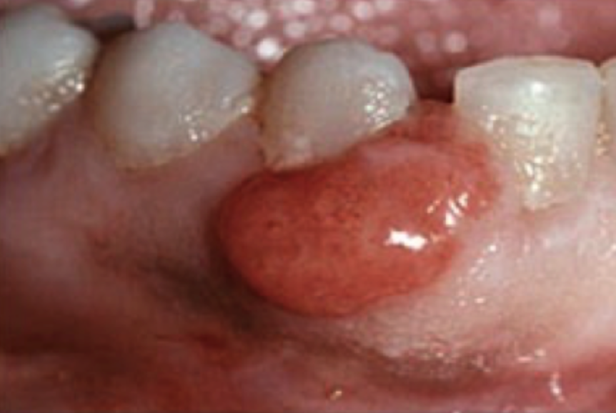
Citation: Wanda C. Gonsalves, M.D., Angela C. Chi, D.M.D, and Brad W.
Neville, D.D.S.; Am Fam Physician. 2007 Feb 15;75(4):509‑512.
During your intraoral exam, you note this lesion.
Station #2 -
Flora’s Intraoral Lesion
Scenario

Slide 21
Citation: Wanda C. Gonsalves, M.D., Angela C. Chi, D.M.D, and Brad W.
Neville, D.D.S.; Am Fam Physician. 2007 Feb 15;75(4):509‑512.
Describe the lesion shown in the photograph.
Station #2 -
Flora’s Intraoral Lesion
Question #1

Slide 22
Citation: Wanda C. Gonsalves, M.D., Angela C. Chi, D.M.D, and Brad W.
Neville, D.D.S.; Am Fam Physician. 2007 Feb 15;75(4):509‑512.
Provide a differential diagnosis (2-3 lesions) and treatment modifications for the lesion(s).
Station #2 -
Flora’s Intraoral Lesion
Question #2

Slide 23
Monitor students working on station #2. Grading rubric is to be used to evaluate students’ written responses.
Station #2 -
Flora’s Intraoral Lesion
Instructions to Faculty

Slide 24
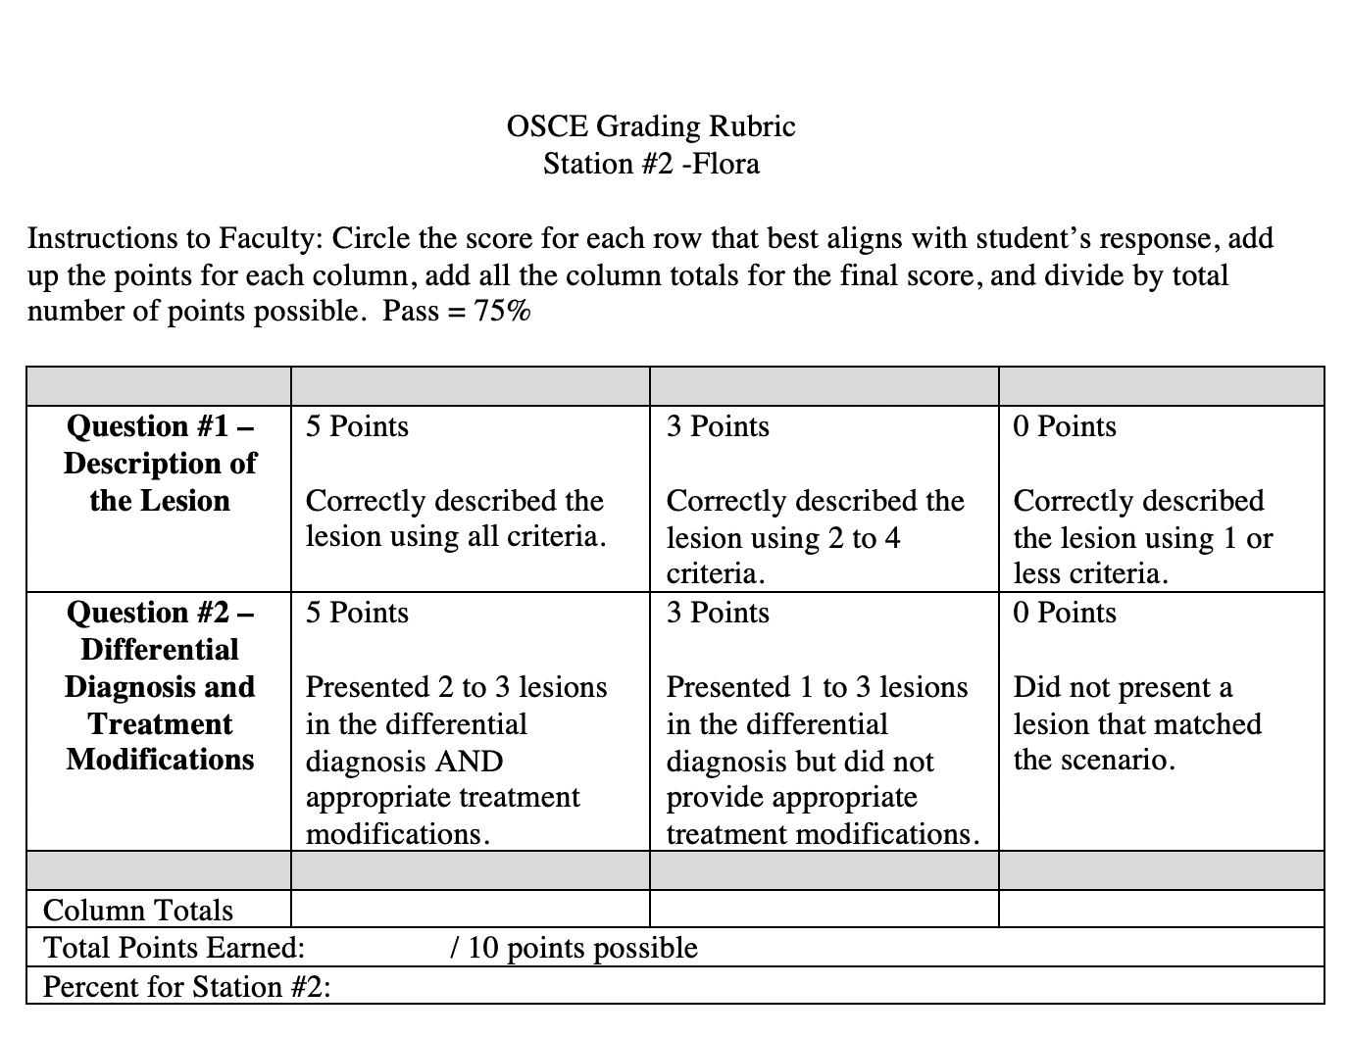
Station #2
Flora’s Intraoral Lesion
Grading Rubric

Slide 25
Station #3
Flora’s Dental Assessment Findings

Slide 26
Station #3
Flora’s Dental Assessment Findings
Instructions to Students
Carefully read the information presented at this station and answer the one question associated with this station. The information presented at this station is to build on and expand the information presented at previous stations.
Always be mindful that you will have 10 minutes to complete this station.

Slide 27
Station #3
Flora’s Dental Assessment Findings
Scenario
Dental history: none and no dental home.
Social history: single, non- alcohol drinker, drinks cola frequently, non-smoker, with no dental insurance and currently attending community college.
EO/IO reveals lesion between teeth # 27- #28.
Occlusion: Class I bilateral orthognathic profile.

Slide 28
Station #3
Flora’s Dental Assessment Findings
Scenario
Clinical evidence of extensive decay on teeth #14 and #15. Suspicious decay on teeth #2, #18, and #31.Teeth #7- #10 appear smooth/shiny/yellow/translucent at the incisal edges. No restorations.
CAMBRA: high risk.
Periodontal findings reveal probing depths range from 3-4mm with generalized bleeding upon probing. No mobility. Facial recession 1mm on teeth #22 and #27.

Slide 29
Station #3
Flora’s Dental Assessment Findings
Scenario
Gingival description: Moderate inflammation with generalized edema, erythema, and marginal and papillary enlargement with loss of stippling on the facial aspect of mandibular anterior teeth. Lesion between teeth #27 and #28 extending from the free gingival margin to attached gingiva.
Moderate generalized subgingival & supragingival calculus
Plaque score: 56%

Slide 30
Station #3
Flora’s Dental Assessment Findings
Question #1
Present the pros and cons of taking radiographs on Flora. Would you recommend radiographs?

Slide 31
Monitor students working on station #3. Grading rubric is to be used to evaluate students’ written responses.
Station #3
Flora’s Dental Assessment Findings
Faculty Instructions

Slide 32
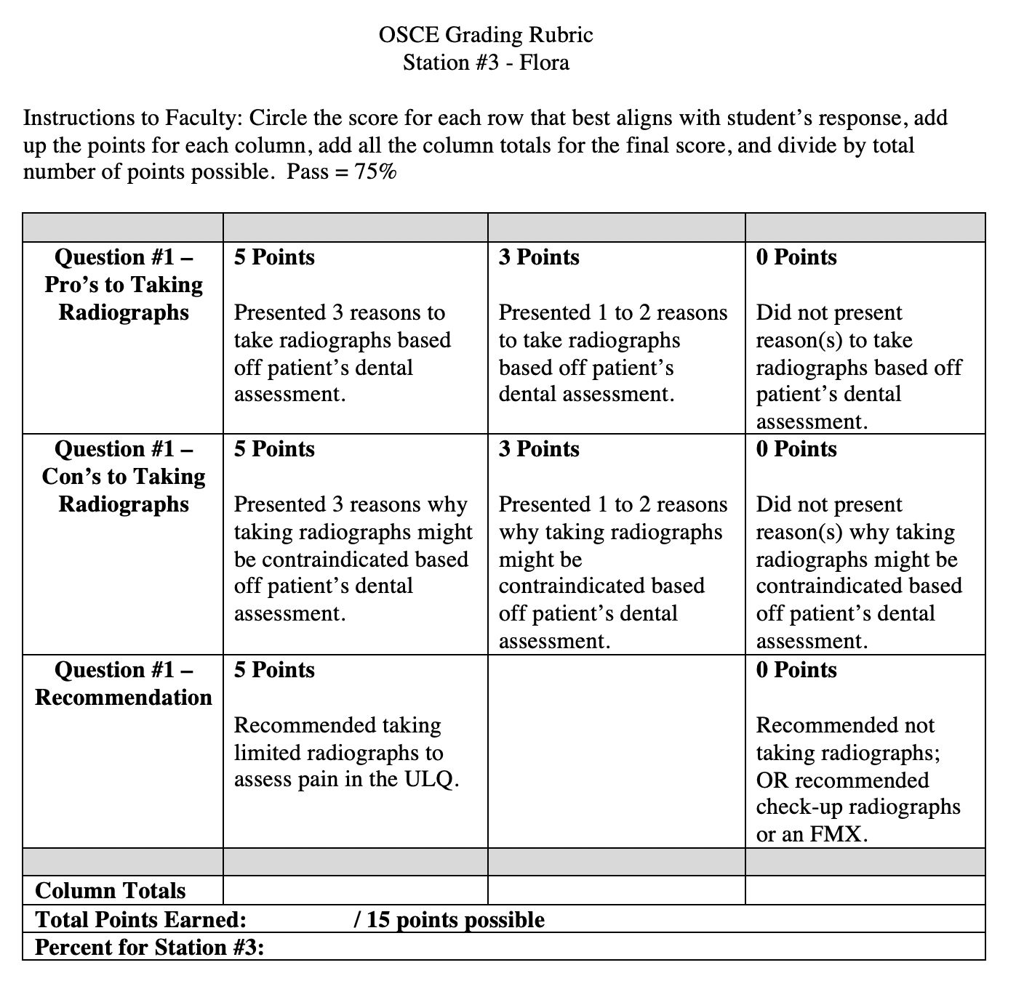
Station #3
Flora’s Dental Assessment Findings
Grading Rubric

Slide 33
Station #4
Flora’s Treatment Plan

Slide 34
Station #4
Flora’s Treatment Plan
Instructions to Students
Carefully read the information presented at this station and answer the one question associated with this station. The information presented at this station is to build on and expand the information presented at previous stations.
Always be mindful that you will have 10 minutes to complete this station.

Slide 35
Station #4
Flora’s Treatment Plan
Scenario
Prior to starting treatment, a detailed treatment plan is required.

Slide 36
Station #4
Flora’s Treatment Plan
Question #1
Using the following template, develop a treatment plan for Flora. Due to the limited time frame for this station, present the problem with the highest urgency.
Dental Hygiene Diagnosis
Problem #1:__________________
Related to:___________________
Goal:______________________
Recommended intervention:________________
Expected Outcome:_______________________

Slide 37
Station #4
Flora’s Treatment Plan
Faculty Instructions
Monitor students working on station #4. Grading rubric is to be used to evaluate students’ written responses.

Slide 38
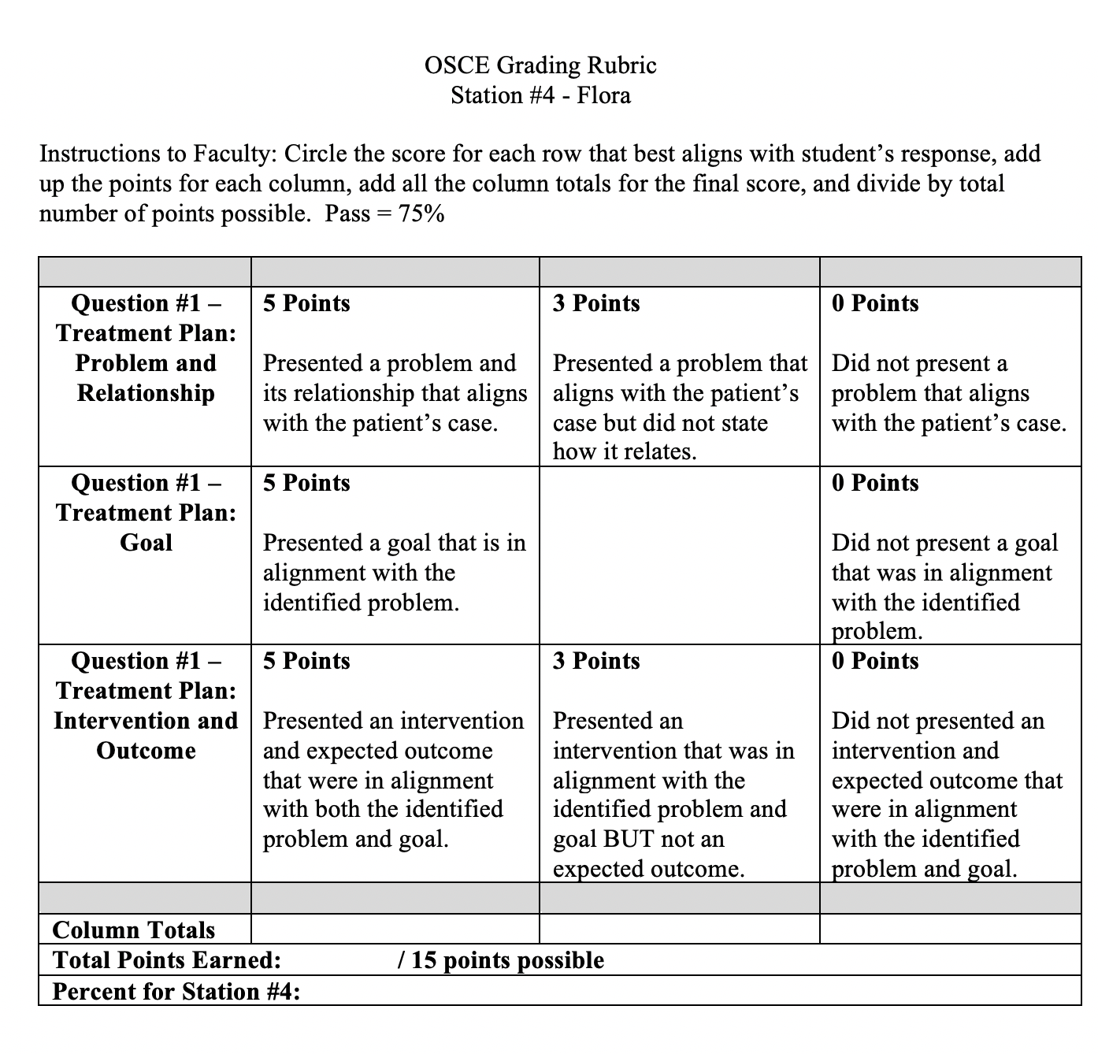
Station #4
Flora’s Treatment Plan
Grading Rubric
.

Slide 39
Station #5
Flora’s Oral Hygiene Education

Slide 40
Station #5
Flora’s Oral Hygiene Education
Instruction to Students
Carefully read the information presented at this station and answer the one question associated with this station. The information presented at this station is to build on and expand the information presented at previous stations.
Always be mindful that you will have 10 minutes to complete this station.

Slide 41
Through your discussion with Flora, it becomes evident she is interested in improving her oral health and is motivated to make behavior changes that will support having a healthy baby.
Station #5
Flora’s Oral Health Education
Scenario

Slide 42
Provide two oral hygiene concepts that you would discuss with Flora, including a rationale for each.
Station #5
Flora’s Oral Health Education
Question #1

Slide 43
Monitor students working on station #5. Grading rubric is to be used to evaluate students’ written responses
Station #5
Flora’s Oral Health Education
Faculty Instructions

Slide 44
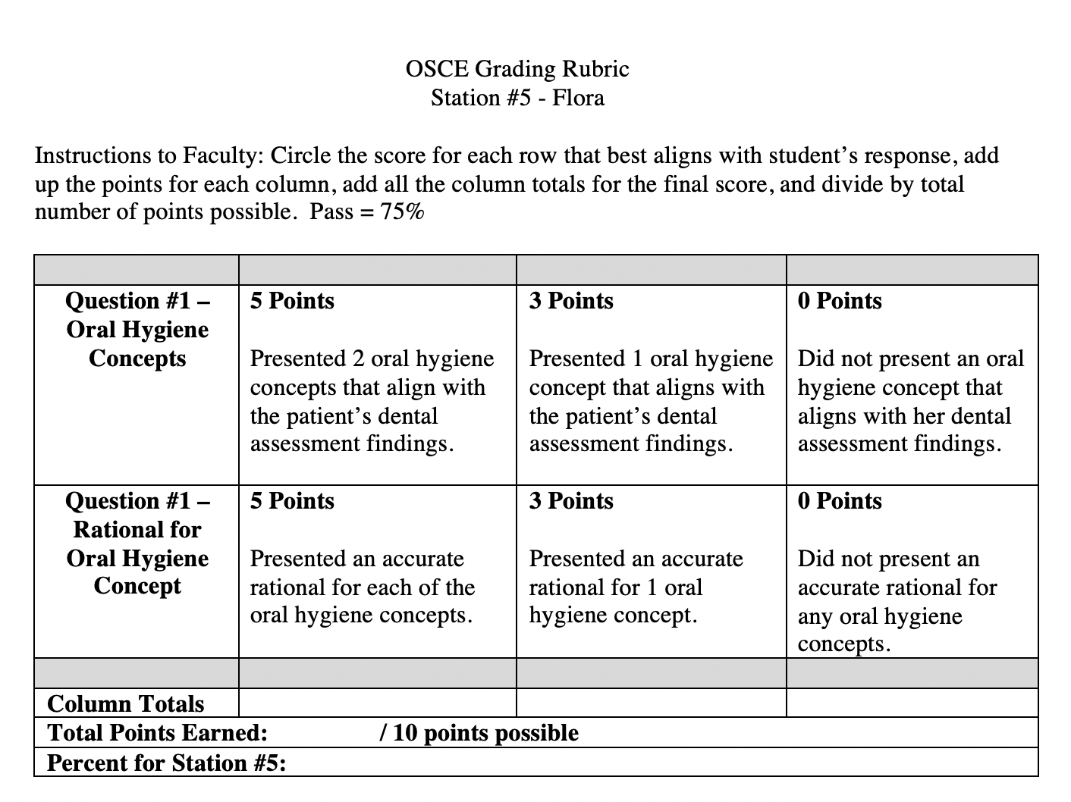
Station #5
Flora’s Oral Health Education
Grading Rubric

Slide 45
Station #6
Flora’s Post Delivery Health Recommendations

Slide 46
Station #6
Flora’s Post Delivery Health Recommendations
Student Instructions
Carefully read the information presented at this station and answer the one question associated with this station. The information presented at this station is to build on and expand the information presented at previous stations.
Always be mindful that you will have 10 minutes to complete this station.

Slide 47
Flora asks if you have any recommendations for oral health practices she can incorporate to improve her baby’s oral health.
Station #6
Flora’s Post Delivery Health Recommendations
Scenario

Slide 48
Present two oral health recommendations for Flora’s baby and a rationale for each recommendation.
Station #6
Flora’s Post Delivery Health Recommendations
Question #1

Slide 49
Monitor students working on station #6. Grading rubric is to be used to evaluate students’ written responses.
Station #6
Flora’s Post Delivery Health Recommendations
Faculty Instructions

Slide 50
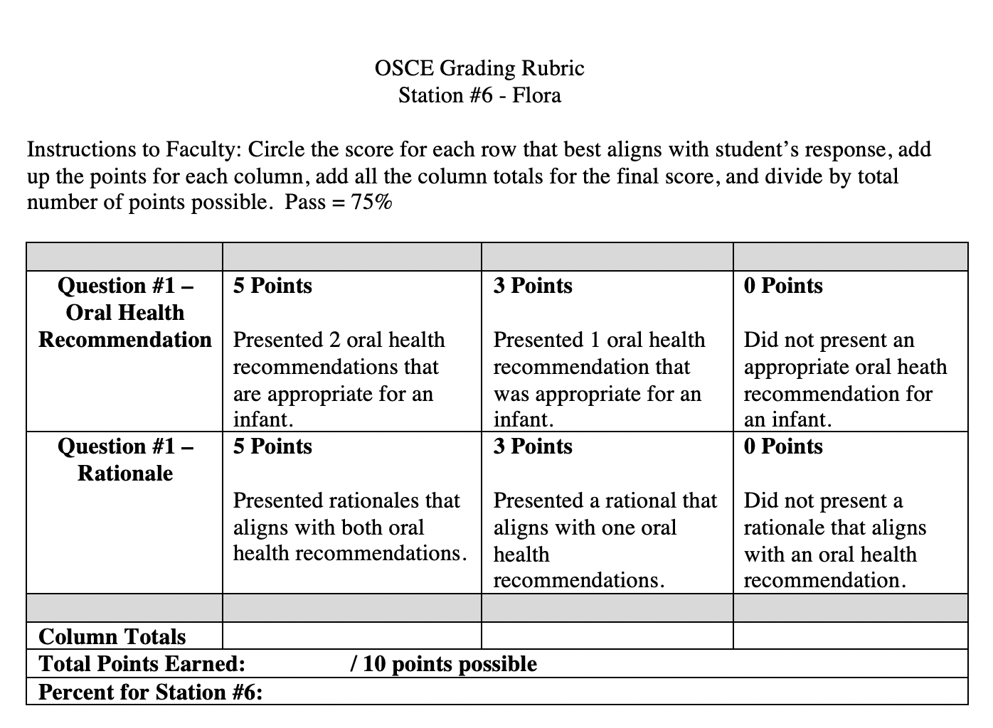
Station #6
Flora’s Post Delivery Health Recommendations
Grading Rubric

Slide 51
Station #7
Documentation of Flora’s Appointment

Slide 52
Station #7
Documentation of Flora’s Appointment
Instruction to Students
Carefully read the information presented at this station and answer the one question associated with this station. The information presented at this station is to build on and expand the information presented at previous stations.
Always be mindful that you will have 10 minutes to complete this station.

Slide 53
Station #7
Documentation of Flora’s Appointment
Scenario
You have dismissed Flora after completing the first of a two appointment dental hygiene treatment plan.

Slide 54
Write your clinical notes for your appointment using a SOAP note format.
Station #7
Documentation of Flora’s Appointment
Question #1

Slide 55
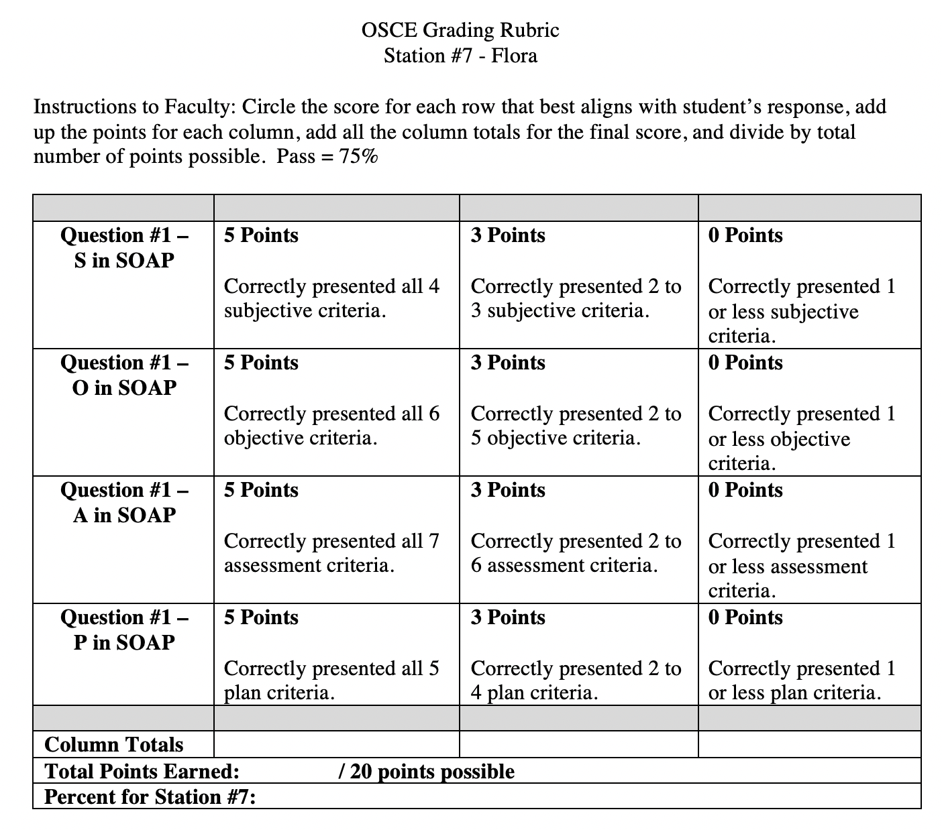
Station #7
Documentation of Flora’s Appointment
Grading Rubric

Slide 56
Congratulations! You have completed the OSCE. Follow the submission process as outlined by the faculty prior to the start of this examination.

